Slide 1
St. jane frances de Chantal parish

Slide 2
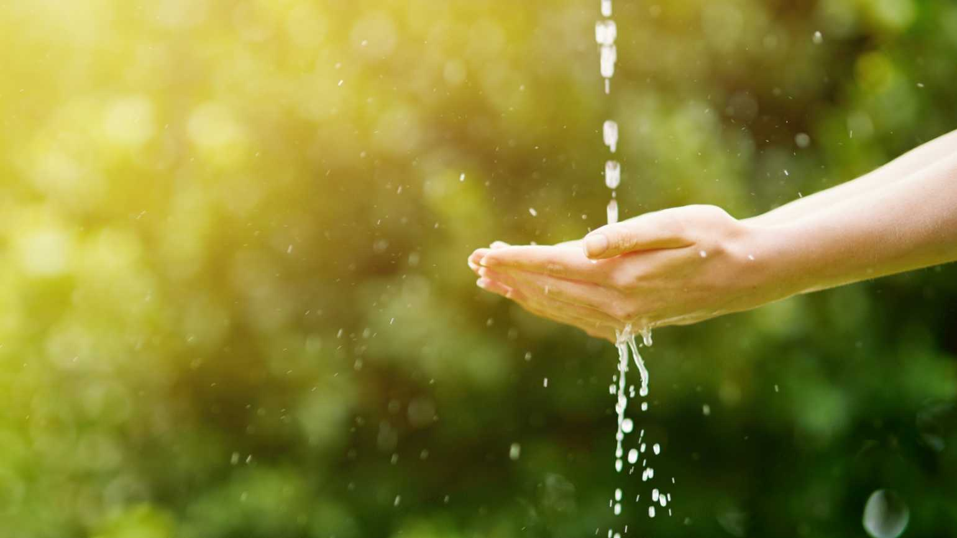
3rd Sunday of Lent – (A)
Quench us, Lord,
with your Son’s
living water
St. jane frances de Chantal parish

Slide 3
A reading from the book of Ex 17, 3-7

Slide 4
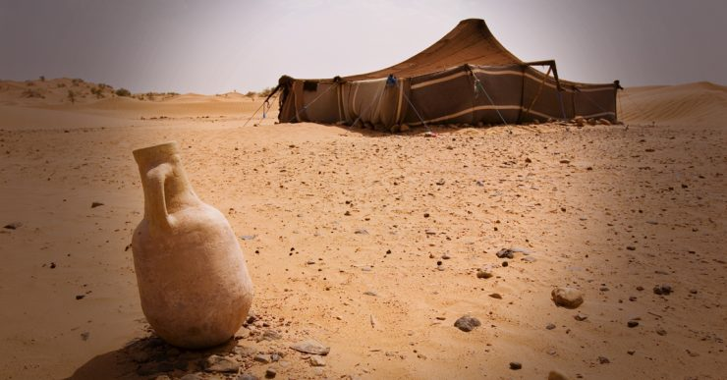
In the
wilderness the people thirsted
for water;

Slide 5
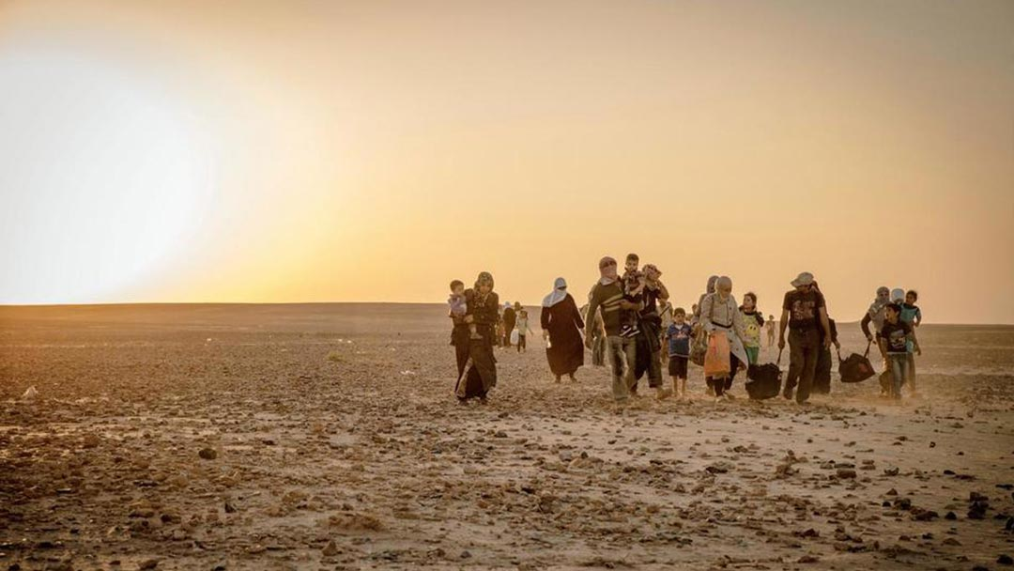
In the wilderness the people thirsted
for water;

Slide 6
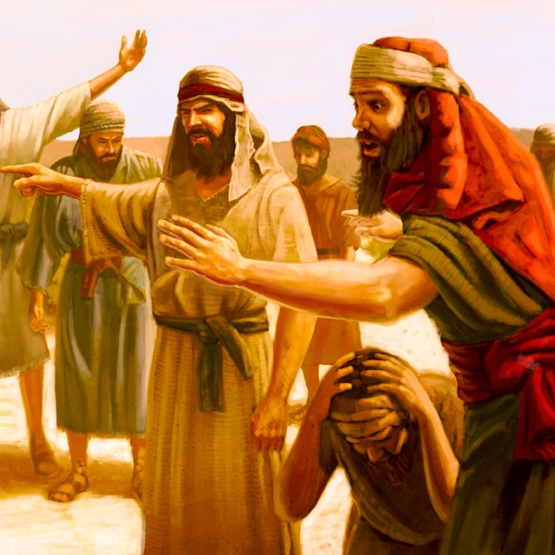
and the people complained against Moses and said,

Slide 7
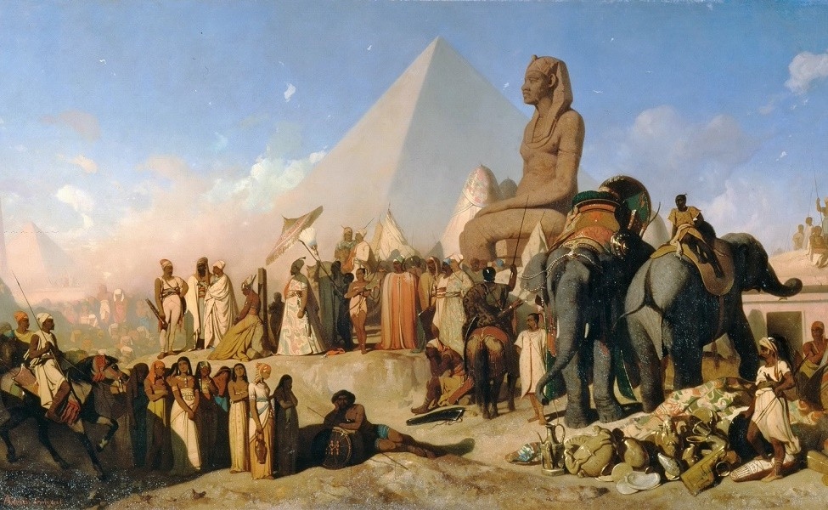
“Why did you bring us out of Egypt,

Slide 8
to kill us and our children and livestock with thirst?”

Slide 9
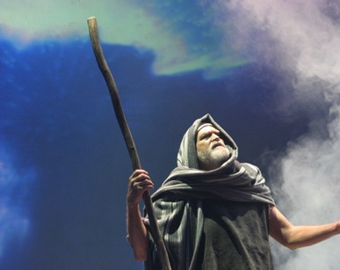
So Moses cried out to the Lord, “What shall I do with this people?

Slide 10
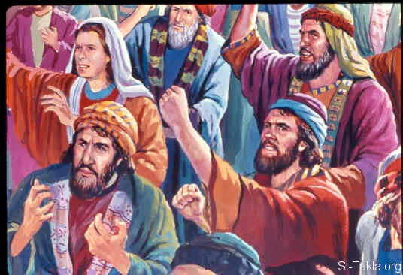
They are almost ready to stone me.”

Slide 11
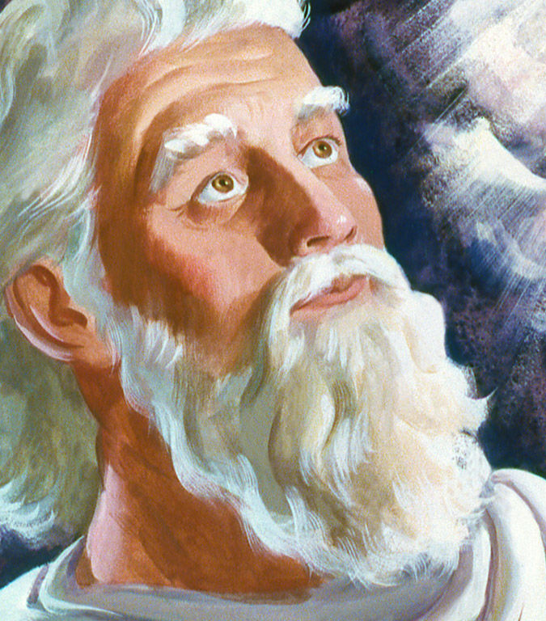
The Lord said to Moses, “Go on ahead of the people,

Slide 12
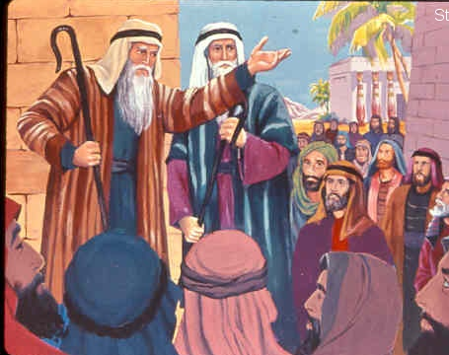
and take some of the elders of Israel with you;

Slide 13
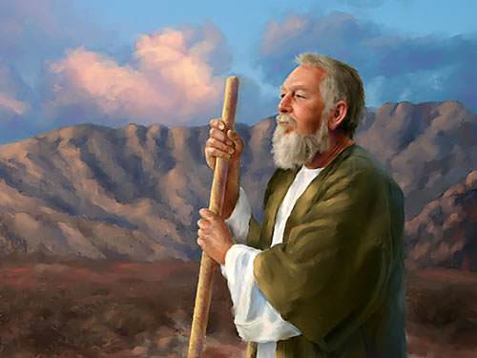
take in your hand the staff with which you struck the Nile, and go.

Slide 14
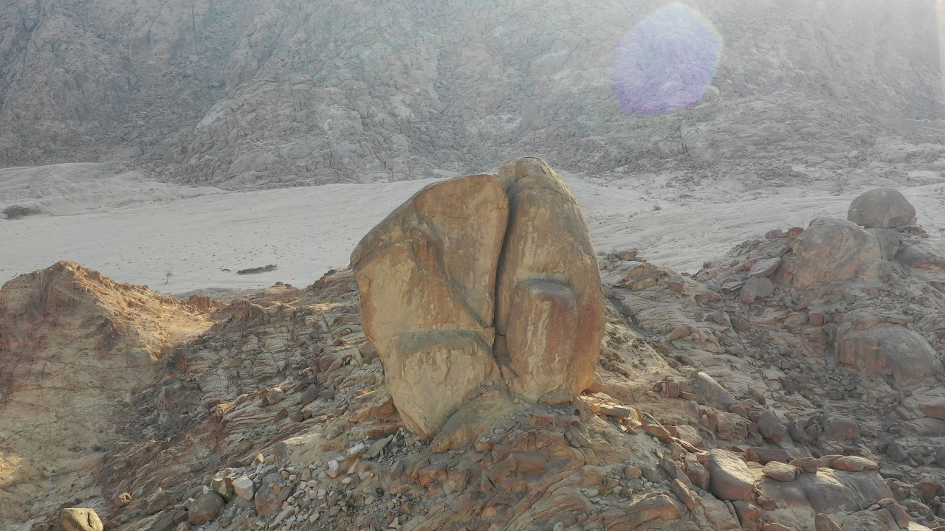
I will be standing there
in front of you
on the rock of Horeb.

Slide 15
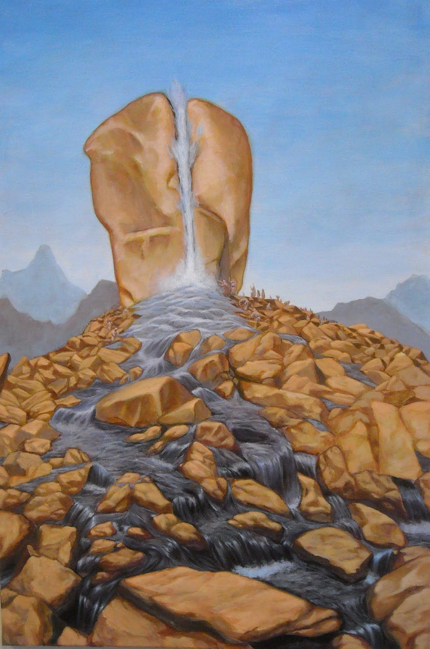
Strike the rock, and water will come out of it, so that the people may drink.”

Slide 16
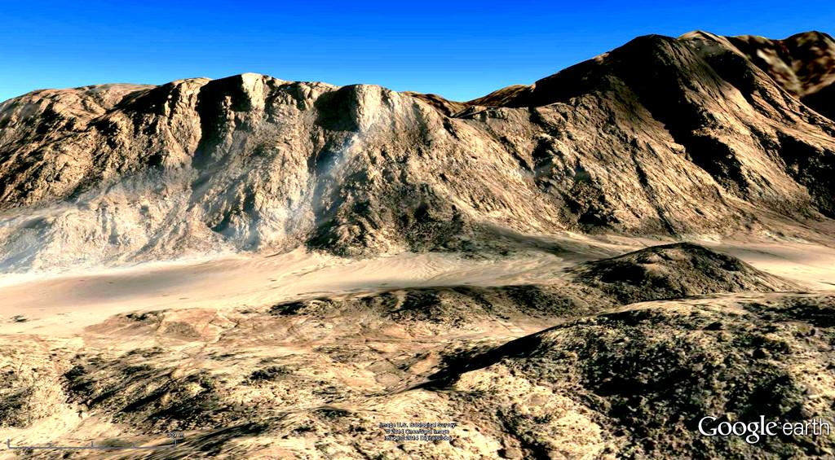
Moses did so, in the sight of the elders of Israel. He called the place Massah and Meribah,

Slide 17
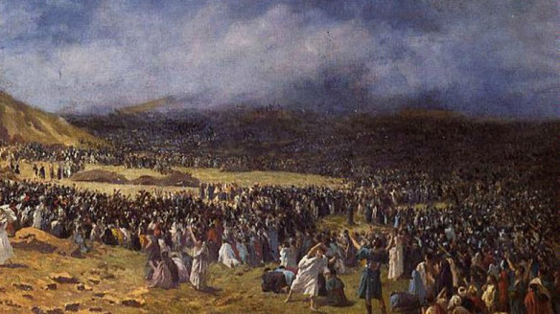
because the children of Israel quarrelled and tested the Lord, saying,

Slide 18
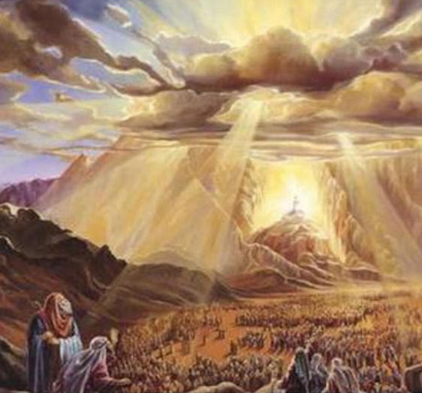
“Is the Lord among us or not?”

Slide 19
The Word
of the Lord
Thanks
be to God.

Slide 20
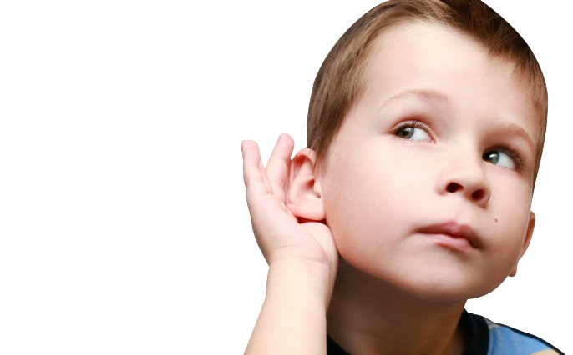
O that today you would listen to the voice
of the Lord.
Do not harden your hearts!

Slide 21
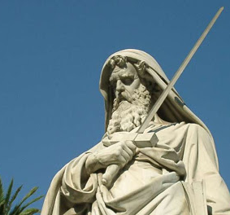
A reading from the letter of Saint Paul to the Romans

Slide 22
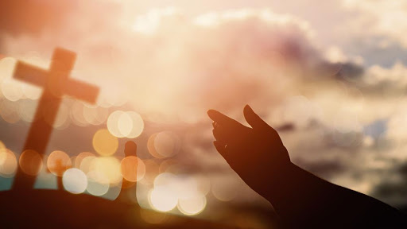
Brothers and sisters: since we are justified
by faith,

Slide 23
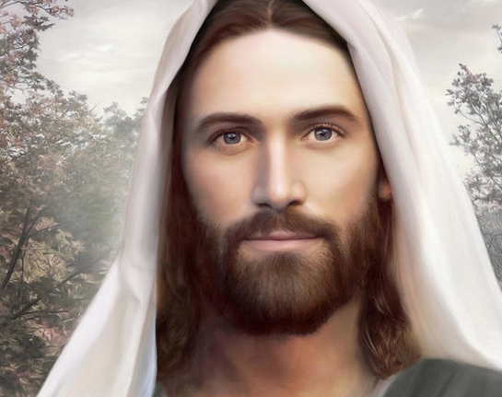
we have peace with God through our Lord Jesus Christ,

Slide 24
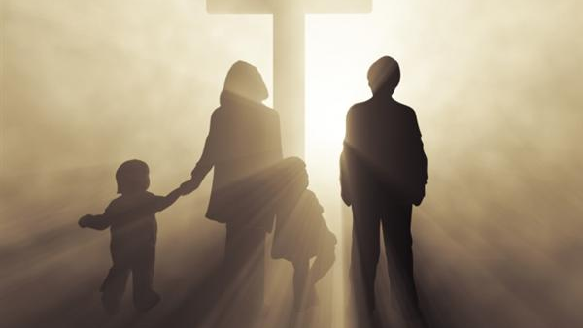
through whom we have obtained access to this grace in which we stand;

Slide 25
and we boast in our hope of sharing the glory of God.

Slide 26
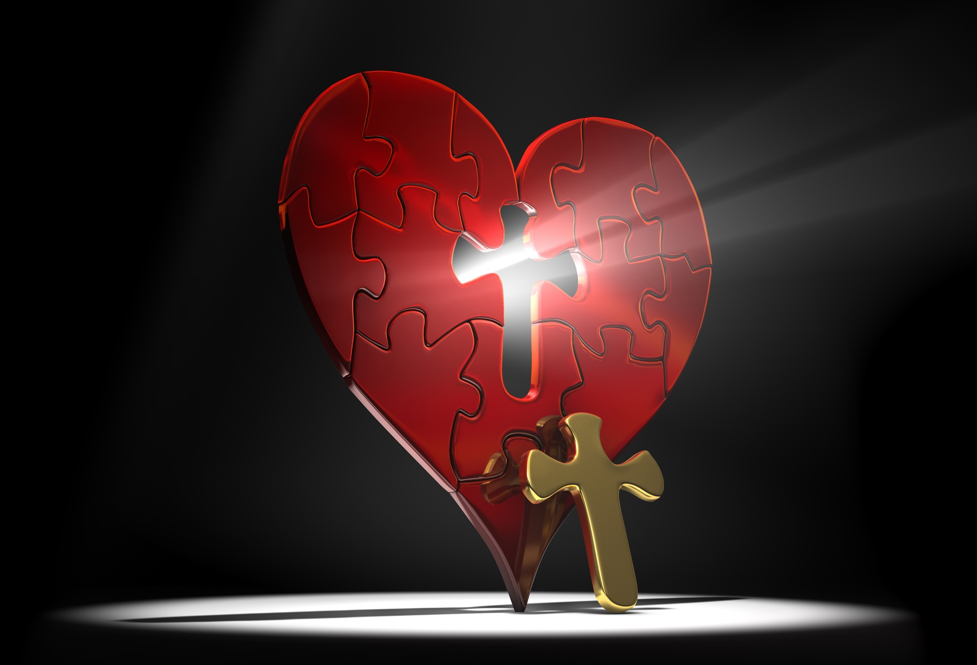
And hope does not disappoint us, because God’s love has been poured into our hearts

Slide 27
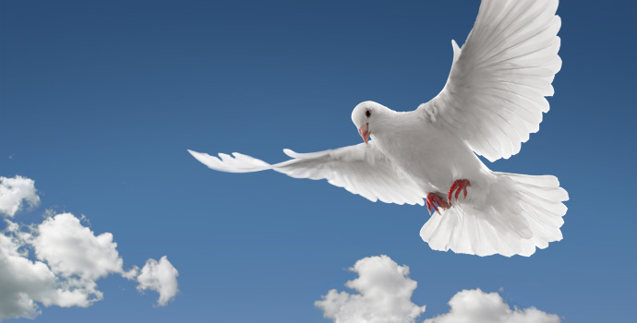
through the Holy Spirit that has been given to us.

Slide 28
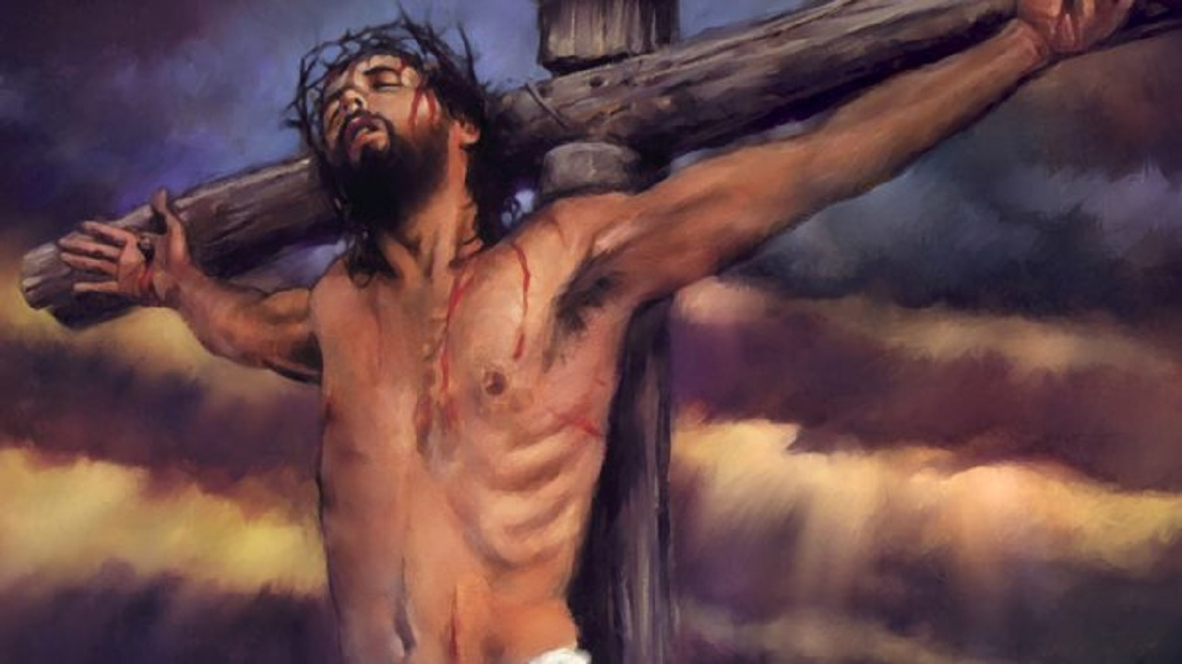
For while we were still weak, at the right time Christ died for the ungodly.

Slide 29
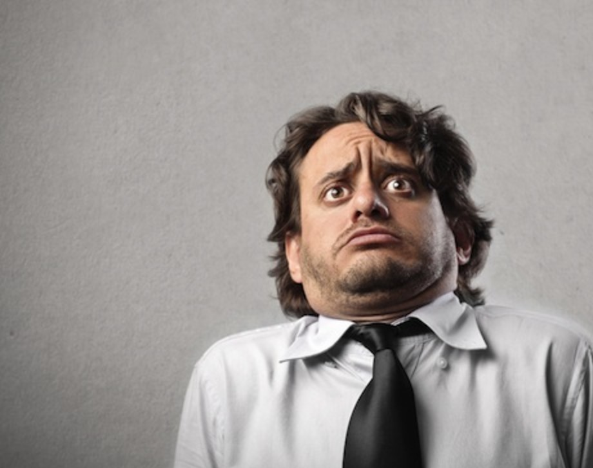
Indeed, rarely will anyone die for a righteous person

Slide 30
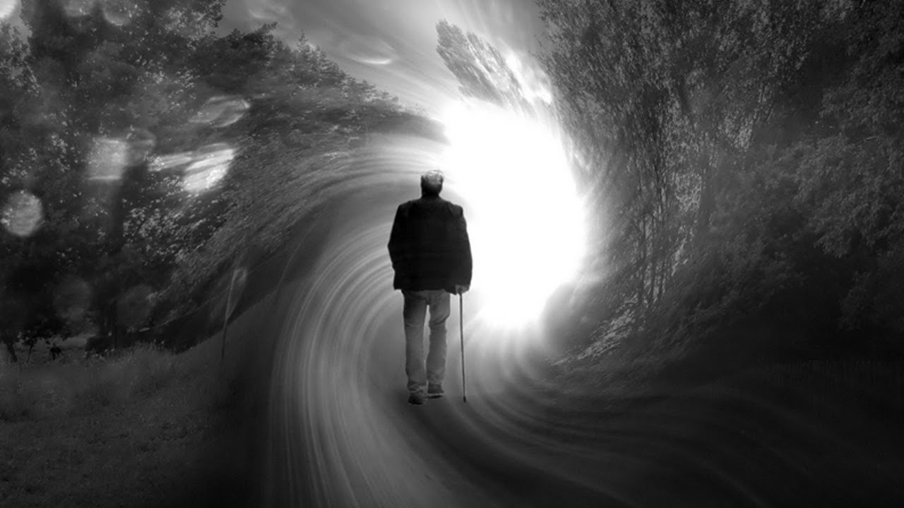
though perhaps for a good person someone might actually dare to die.

Slide 31
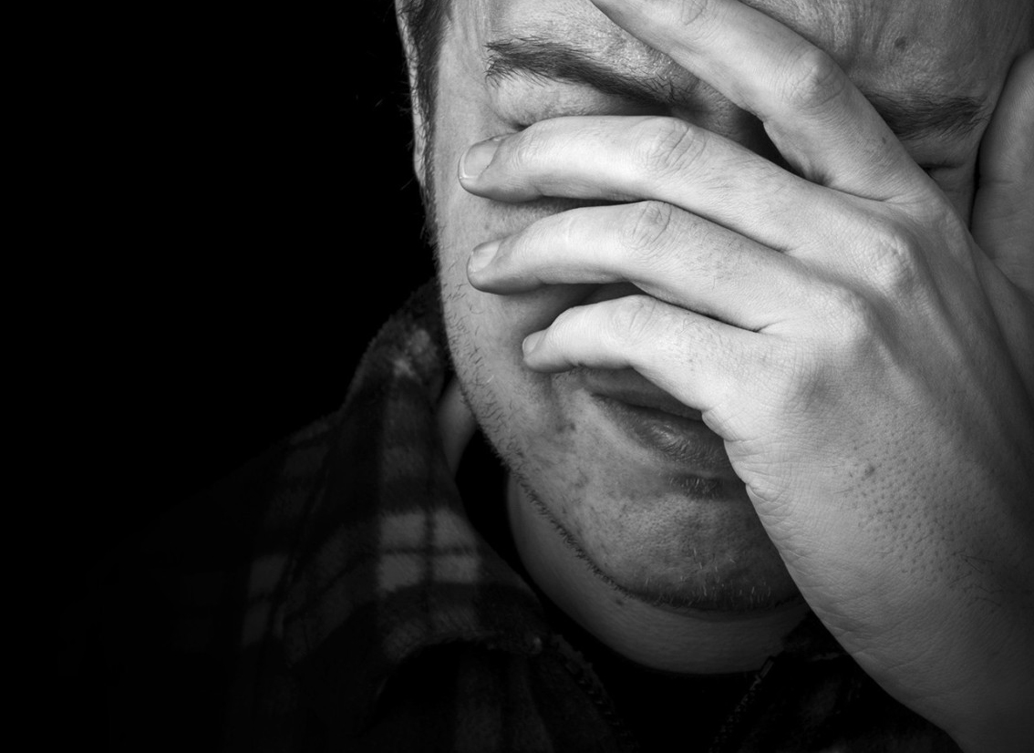
But God proves His love for us in that while we still were sinners Christ died for us.

Slide 32
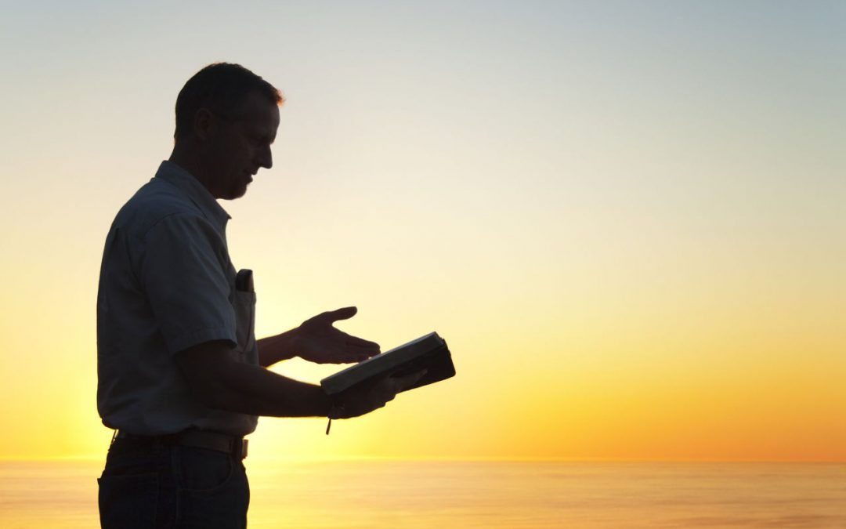
The Word
of the Lord
Thanks
be to God.

Slide 33
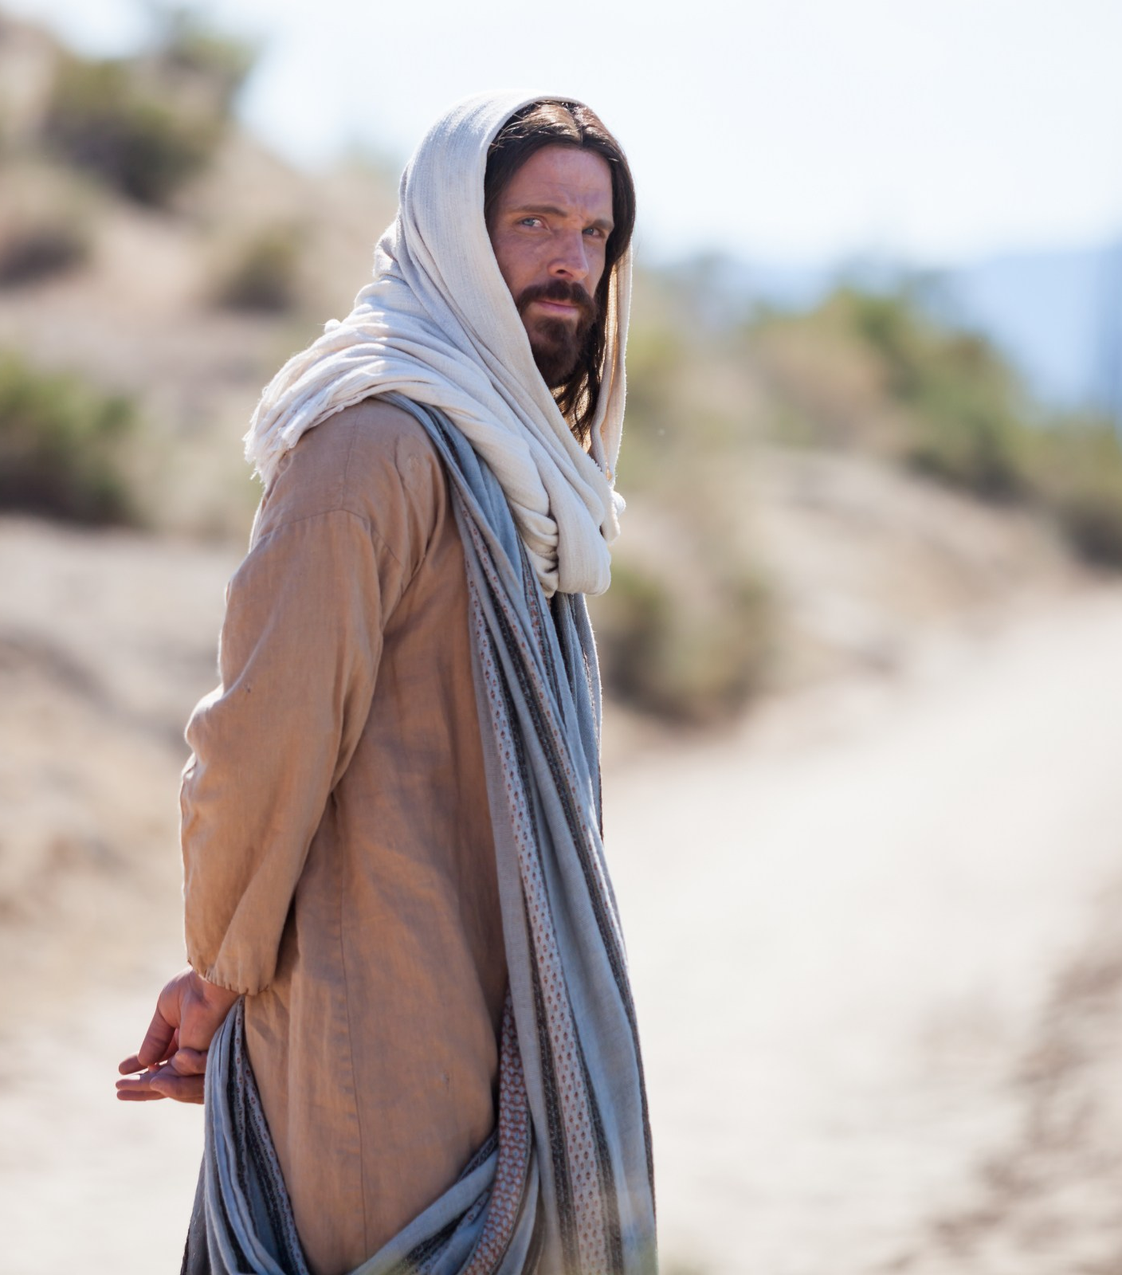
Lord, you are truly the Saviour of the world; give me the living water that I may never be thirsty

Slide 35
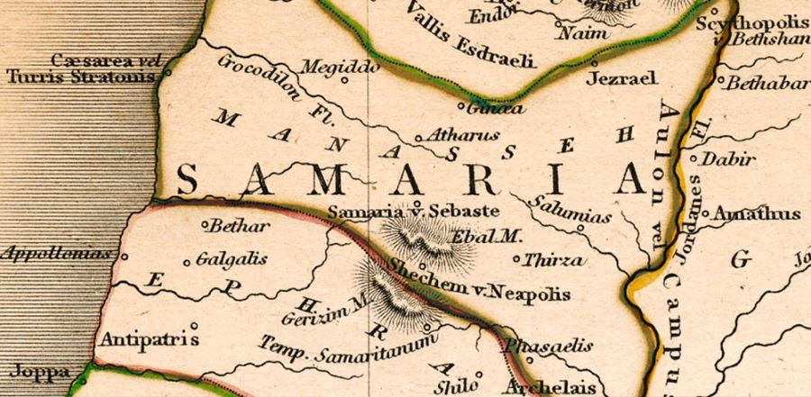
Jesus came to a Samaritan city called Sychar,

Slide 36
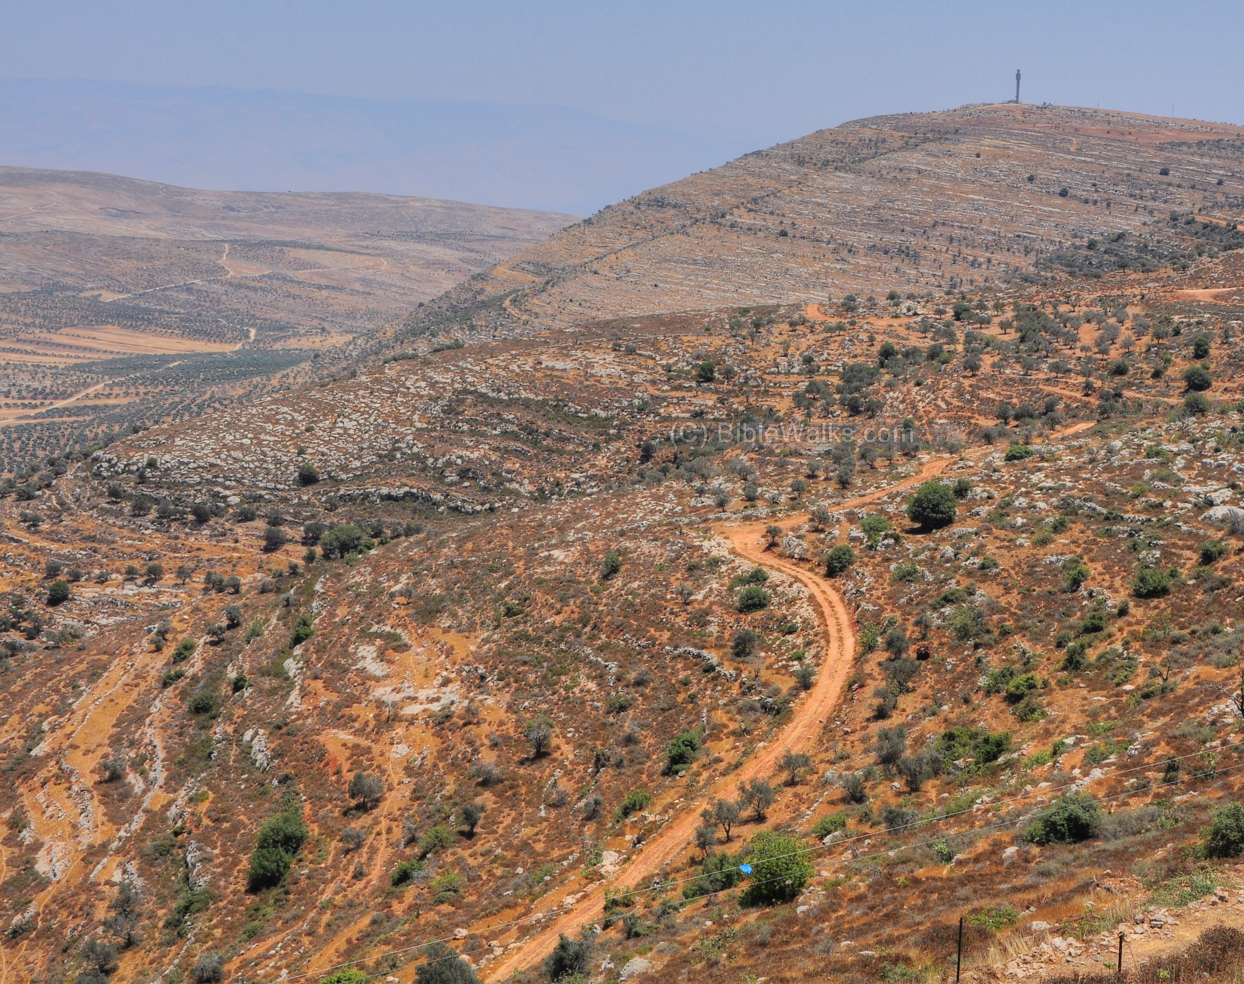
near the plot of ground that Jacob had given to his son Joseph.

Slide 37
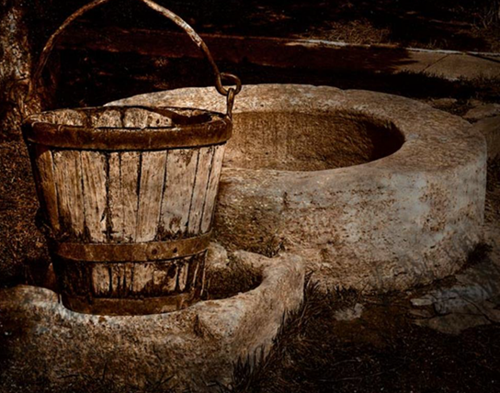
Jacob’s well was there,

Slide 38
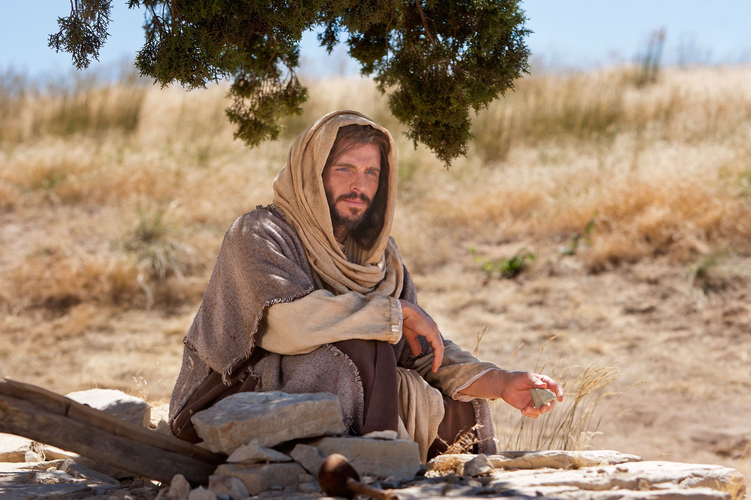
and Jesus, tired out by His journey, was sitting by the well.

Slide 39
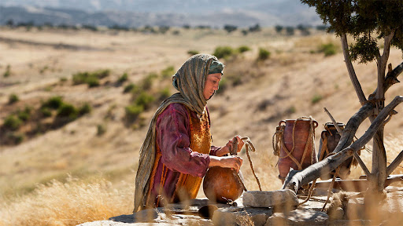
It was about noon. A Samaritan woman came to draw water,

Slide 40
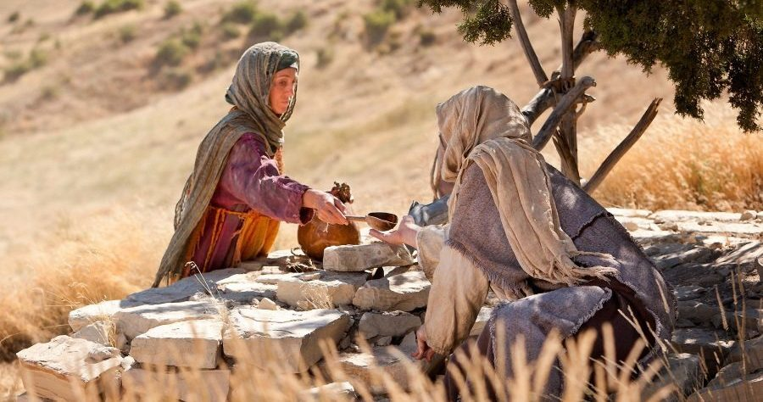
and Jesus said to her, “Give me a drink.”

Slide 41
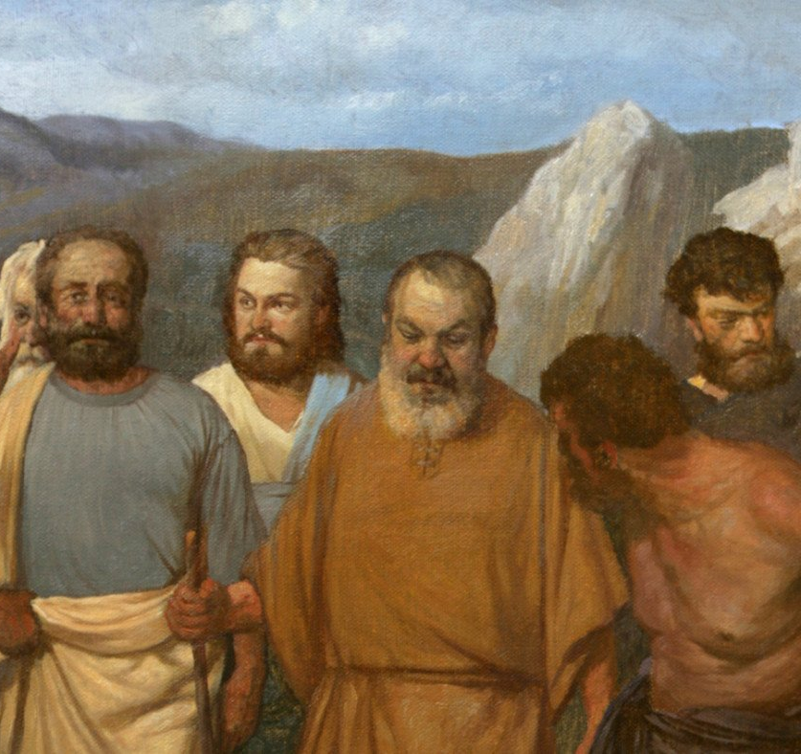
His disciples had gone to the city to buy food.

Slide 42
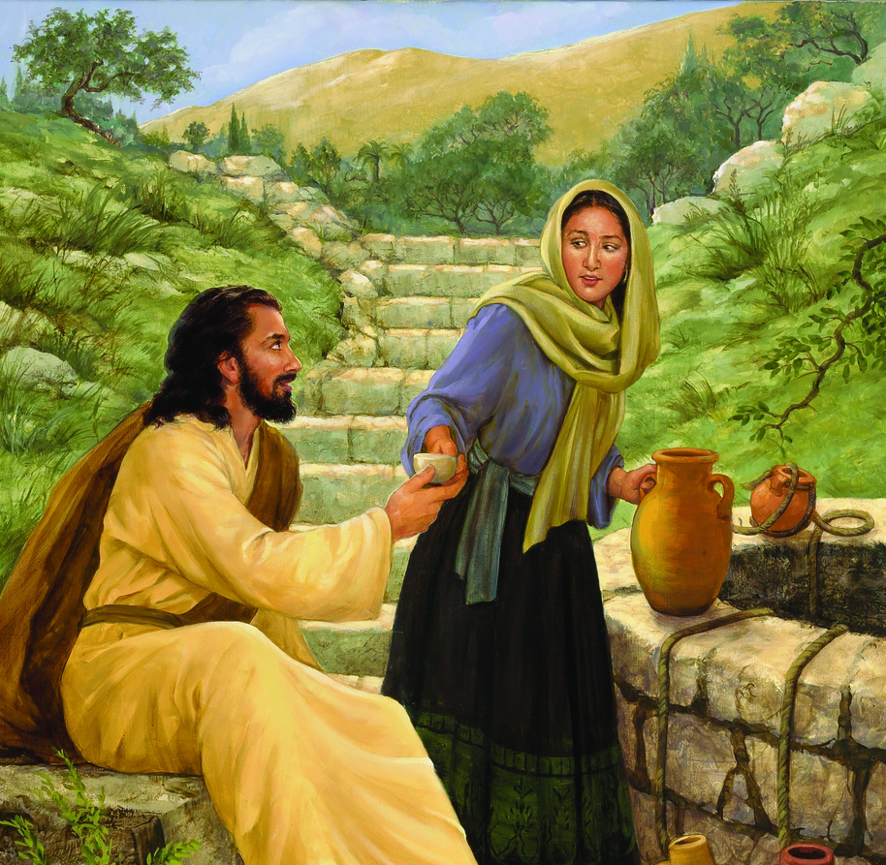
The Samaritan woman said to Him,

Slide 43
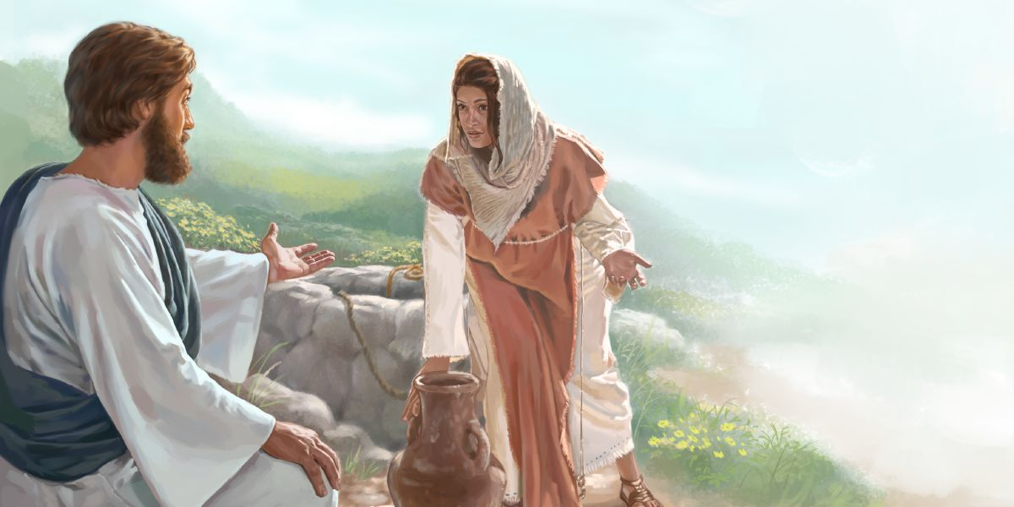
“How is it that you, a Jew, ask a drink of me, a woman of Samaria?”

Slide 44
Jews do not share things in common with Samaritans.
Jesus answered her,

Slide 45
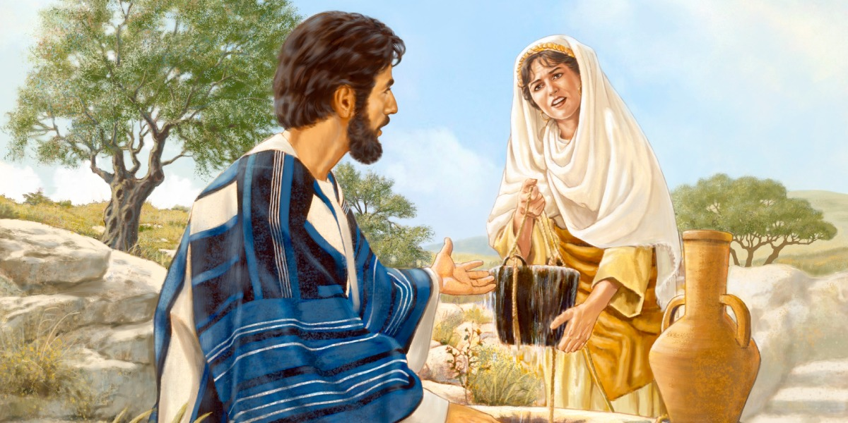
“If you knew the gift of God, and who it is that is saying to you, ‘Give me a drink,’

Slide 46
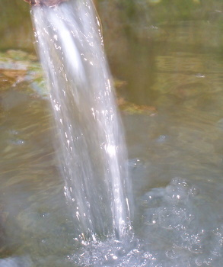
you would have asked him, and he would have given you living water.”

Slide 47
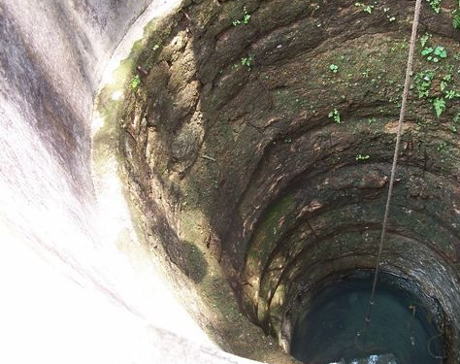
The woman said to Him, “Sir, you have no bucket, and the well is deep.

Slide 48
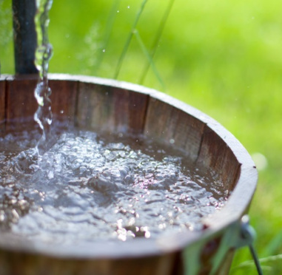
Where do you get that living water?

Slide 49
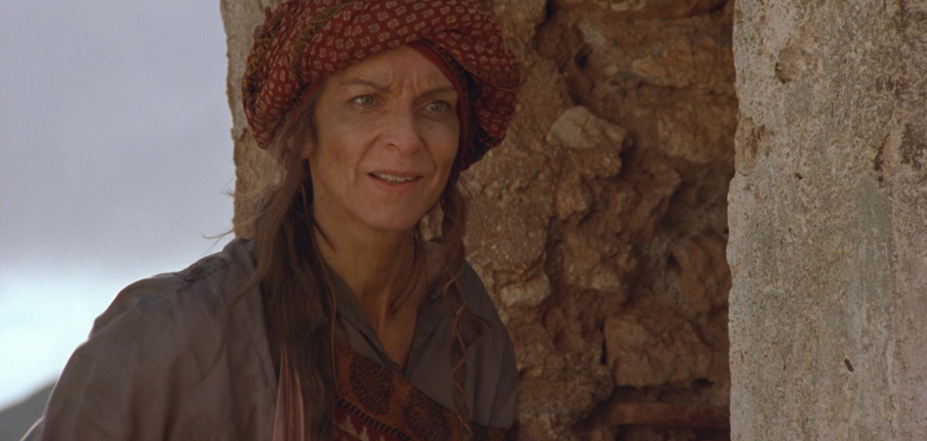
Are you greater than our father Jacob, who gave us the well,

Slide 50
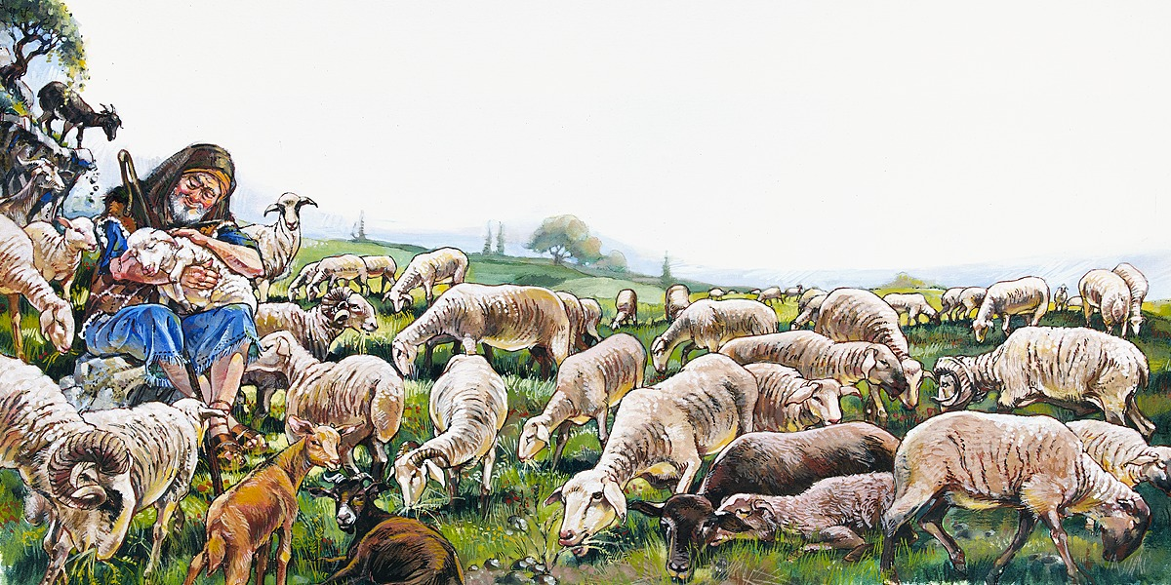
and with his children and his flocks drank from it?”

Slide 51
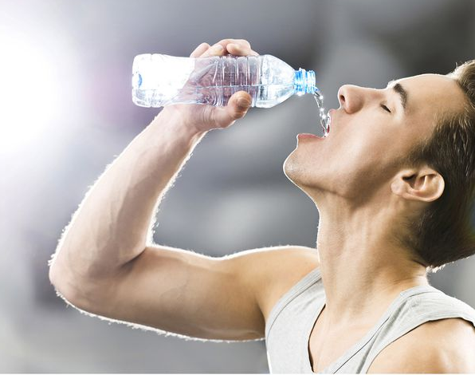
Jesus said to her, “Everyone who drinks of this water will be thirsty again,

Slide 52
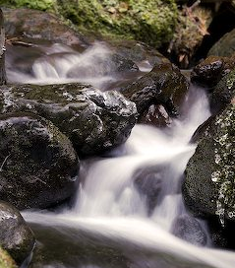
but the one who drinks of the water that I will give will never be thirsty.

Slide 53
The water that I will give him will become in him a spring of water gushing up to eternal life.”

Slide 54
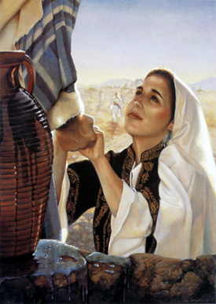
The woman said to him, “Sir, give me this water, so that I may never be thirsty or have to keep coming here to draw water.”

Slide 55
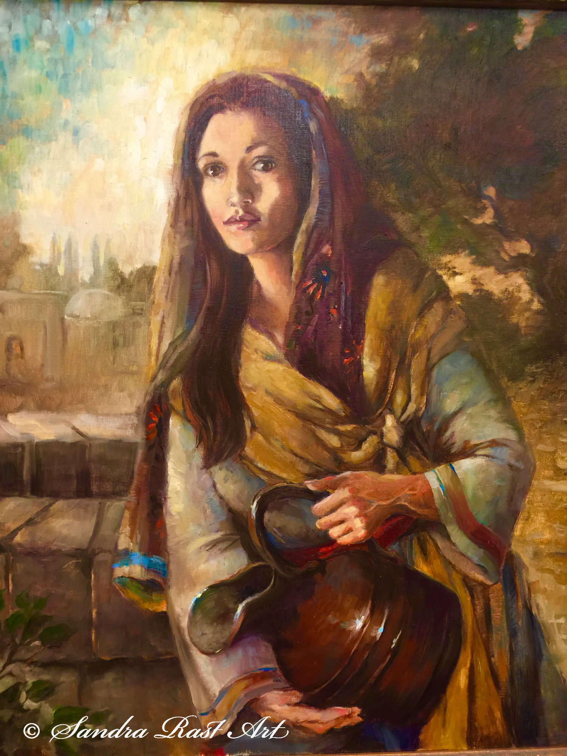
I see that You are a Prophet. Our ancestors worshipped on this mountain,

Slide 56
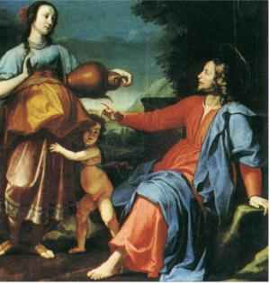
but You say that the place where people must worship is in Jerusalem.” Jesus said to her,

Slide 57
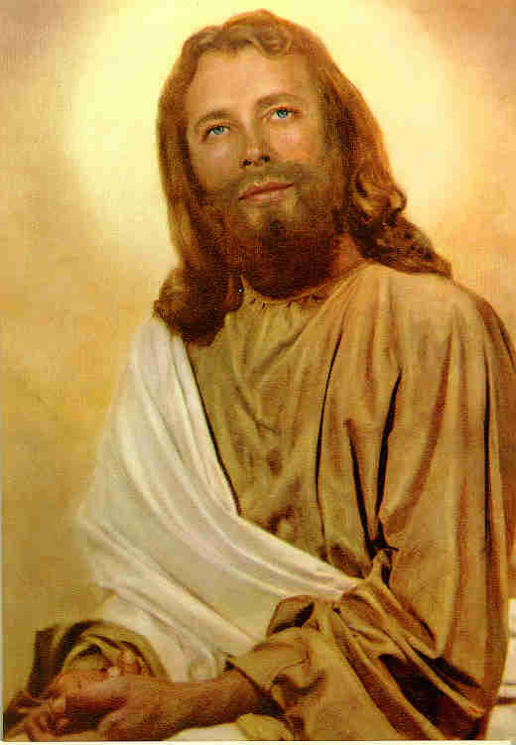
“Woman, believe me, the hour is coming when you will worship the Father neither on this mountain nor in Jerusalem.

Slide 58
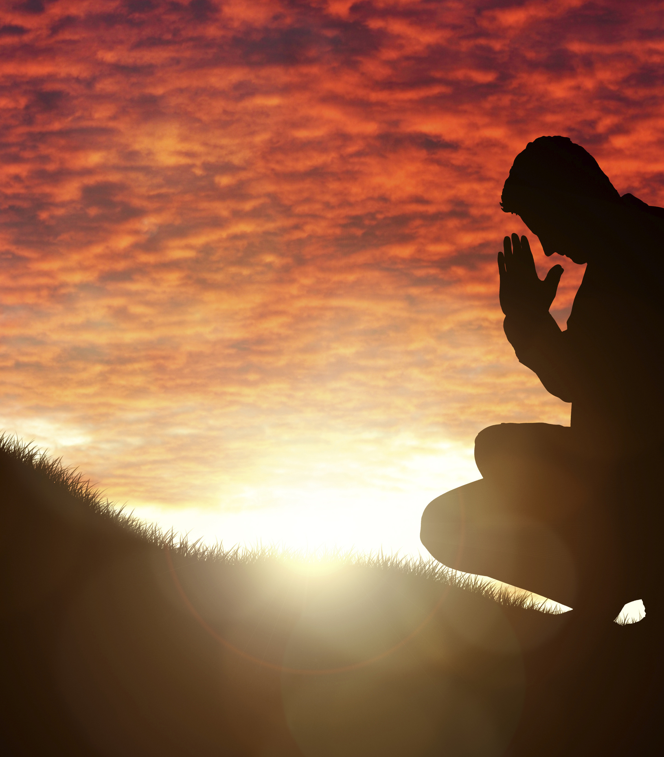
You worship what you do not know; we worship what we know, for salvation is from the Jews.

Slide 59
But the hour is coming, and is now here, when the true worshippers will worship the Father in spirit and truth,

Slide 60
for the Father seeks such as these to worship Him.

Slide 61
God is spirit, and those who worship Him must worship in spirit and truth.”

Slide 62
The woman said to Him, “I know that the Messiah is coming” who is called the Christ.

Slide 63
“When He comes, He will proclaim all things to us.”

Slide 64
Jesus said to her, “I am He, the one who is speaking to you.”

Slide 65
Many Samaritans from that city believed in Jesus.

Slide 66
So when they the Samaritans came to Him, they asked Him to stay with them;

Slide 67
and He stayed there two days. And many more believed because of His word.

Slide 68
They said to the woman, “It is no longer because of what you said that we believe,

Slide 69
for we have heard for ourselves,

Slide 70
and we know that this is truly the Saviour of the world.”

Slide 71
The Word of the Lord
Thanks be to God.

Slide 72
Quench us, Lord,
With your Son’s living water

