Slide 1
6th Sunday Ordinary time (A)
St. jane frances de Chantal parish

Slide 3
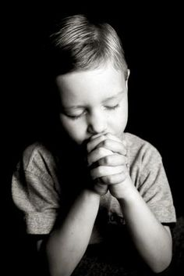
If you choose, you can keep the commandments, and they will save you.

Slide 4
If you trust in God,
you too shall live,

Slide 5
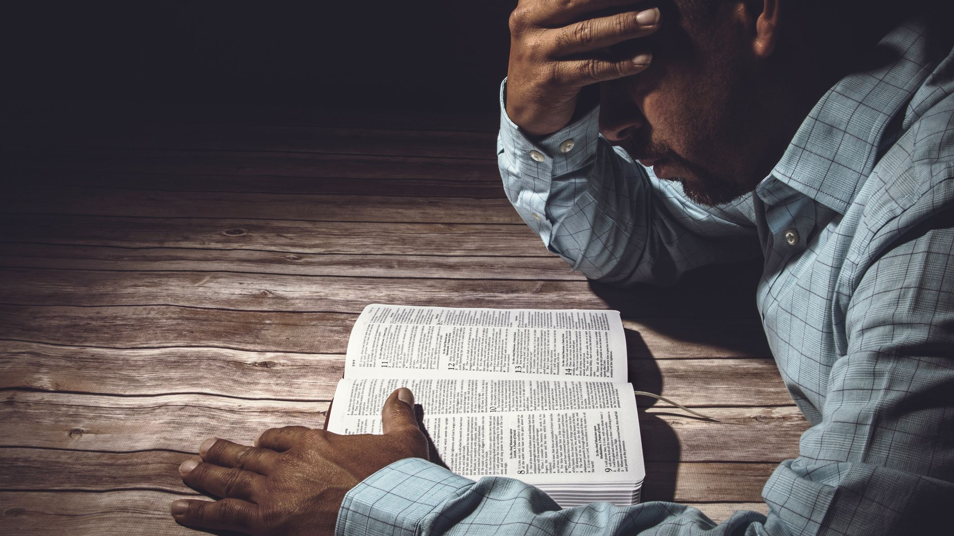
and to act faithfully
is a matter
of your own choice.

Slide 6
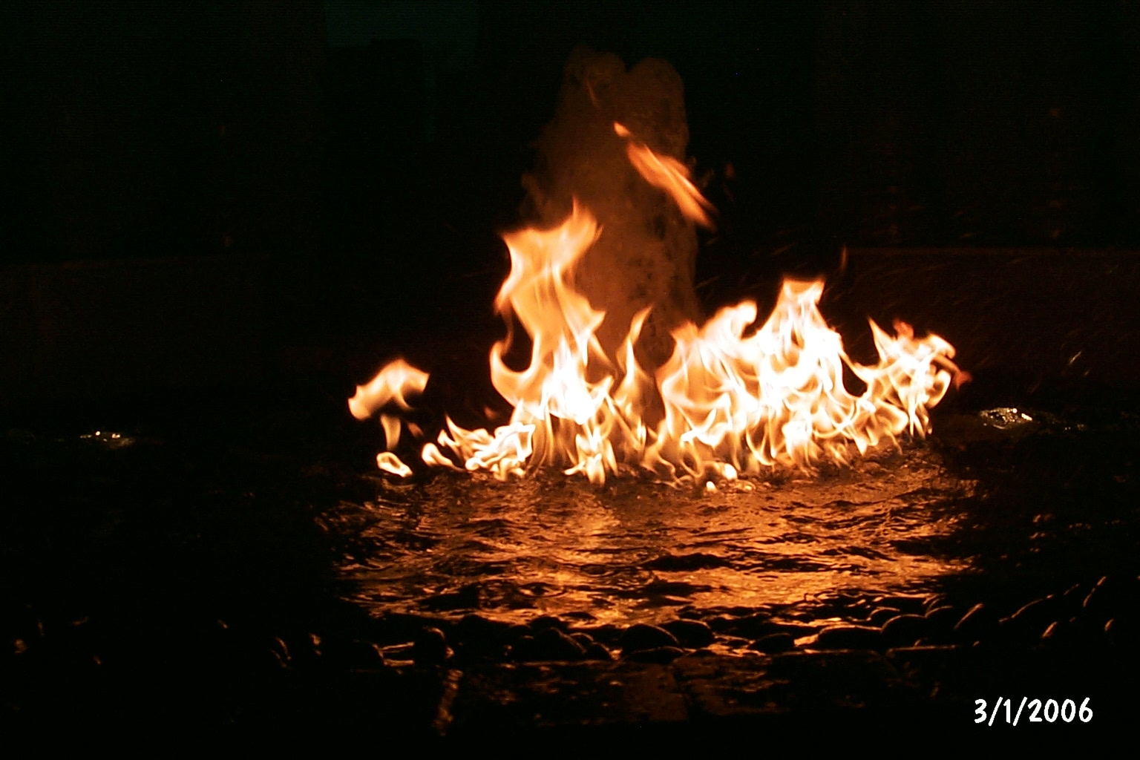
The Lord has placed before you fire and water,

Slide 7
stretch out your hand for whichever you choose.

Slide 8
Before each person
are life and death,

Slide 9
good and evil and whichever one chooses, that shall be given.

Slide 10
For great is
the wisdom
of the Lord;

Slide 11
He is mighty in power and sees everything;

Slide 12
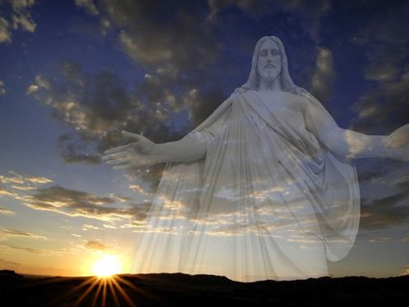
His eyes are on those who fear Him,

Slide 13
and He knows every human action.

Slide 14
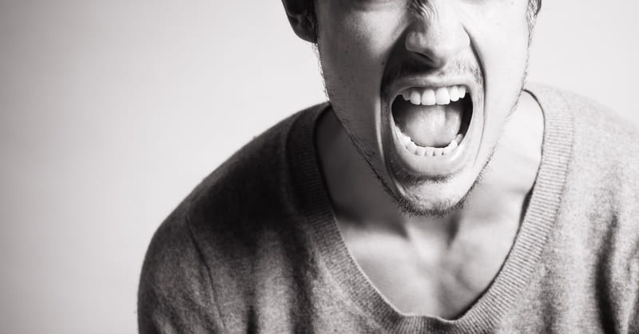
He has not commanded anyone to be wicked,

Slide 15
and He has not given anyone permission to sin.

Slide 16
The Word of the Lord
Thanks be to god

Slide 17
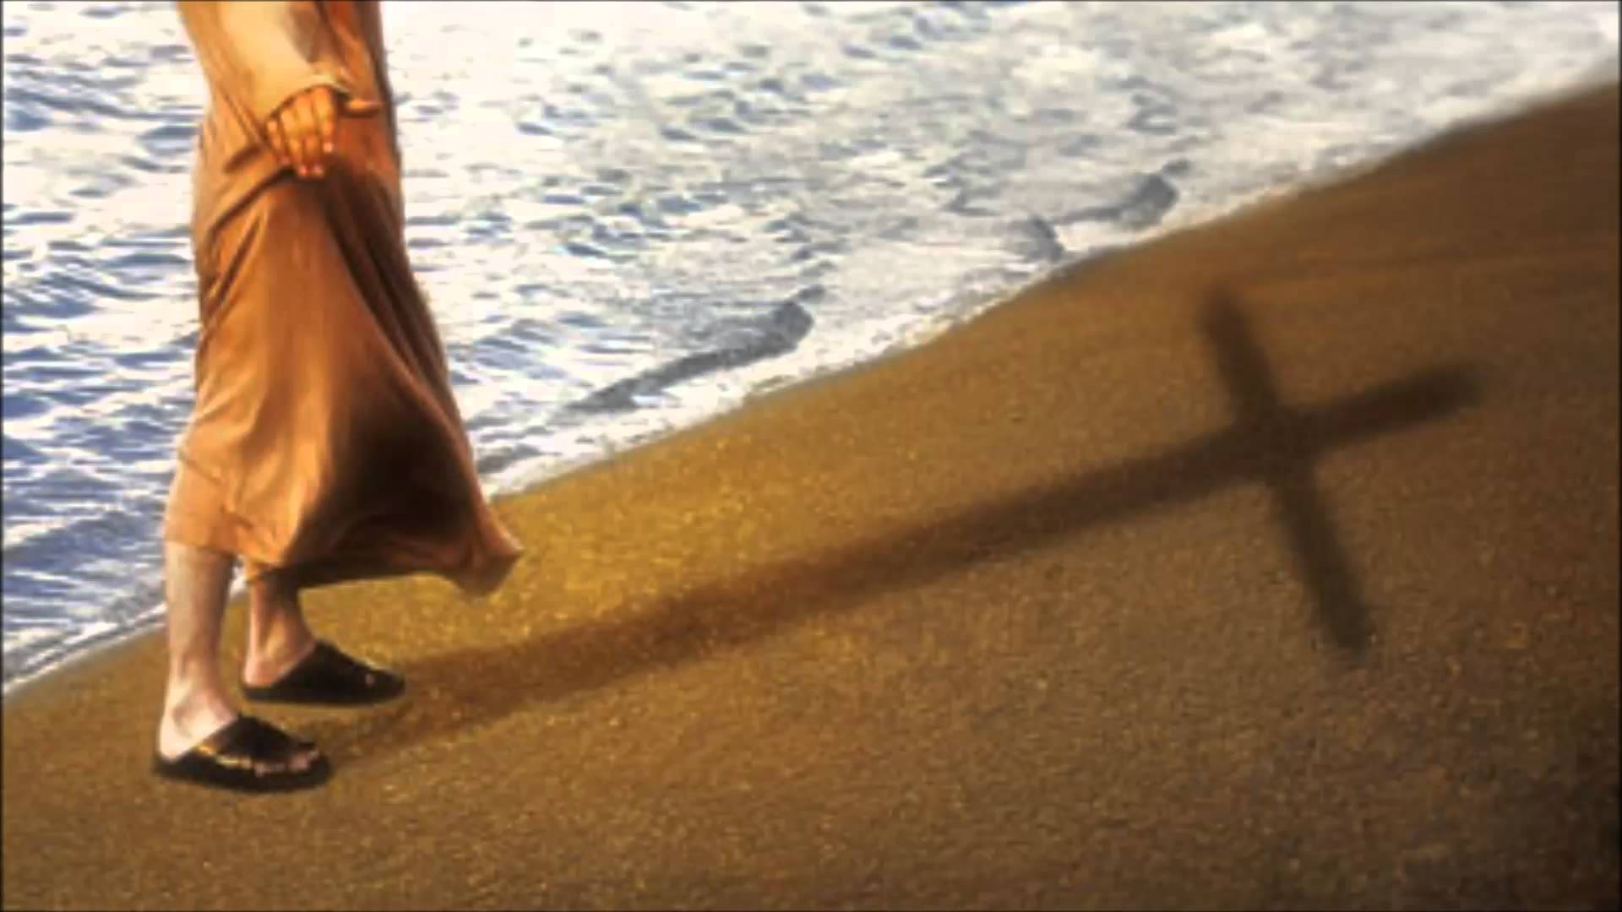
Responsorial psalm:
Blessed are those who walk in the
law of the Lord!

Slide 18
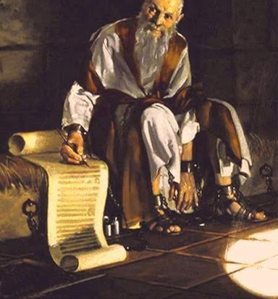
From the letter of Saint Paul
to the Corinthians

Slide 19
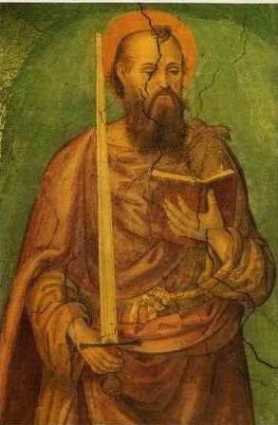
Brothers and sisters: Among the mature we do speak wisdom, though it is not a wisdom of this age

Slide 20
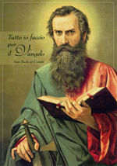
or of the rulers of this age, who are doomed to perish.

Slide 21
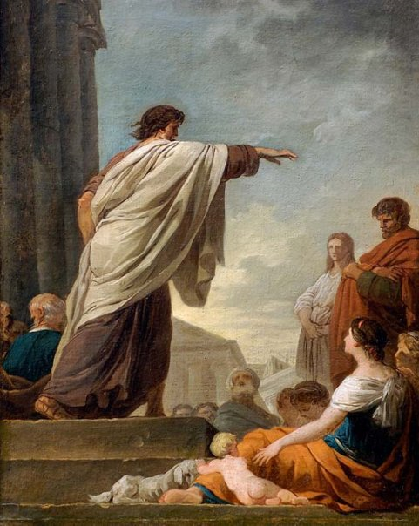
But we speak God’s wisdom, secret and hidden,

Slide 22
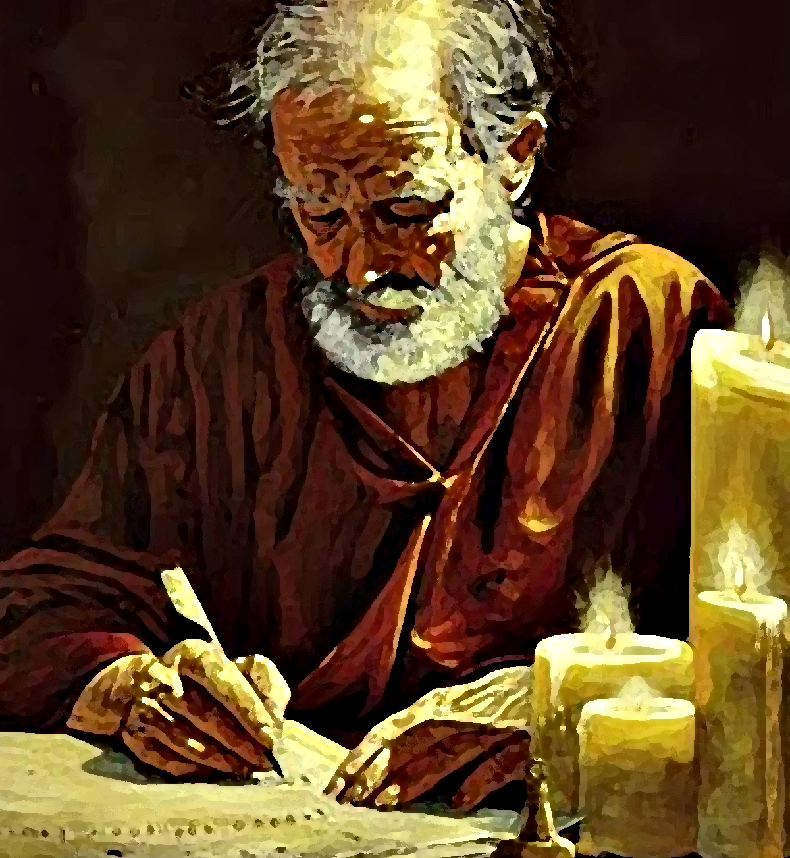
which God decreed before the ages for our glory.

Slide 23
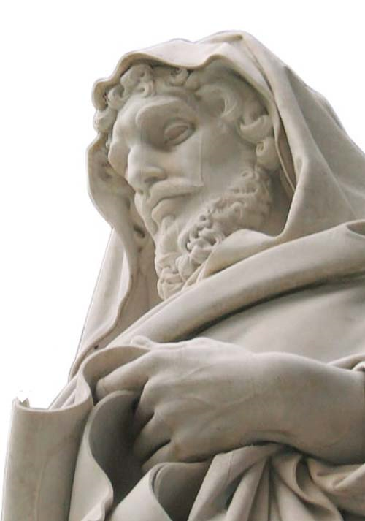
None of the rulers of this age understood this:

Slide 24
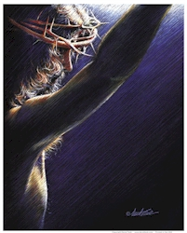
for if they had, they would not have crucified the Lord of glory. As it is written,

Slide 25
What no eye has seen, nor ear heard, nor the human heart conceived,

Slide 26
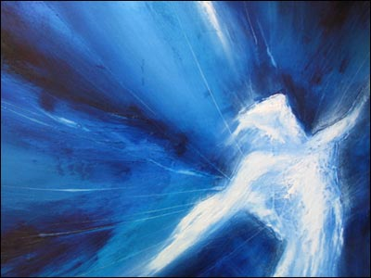
what God has prepared for those who love Him.”

Slide 27
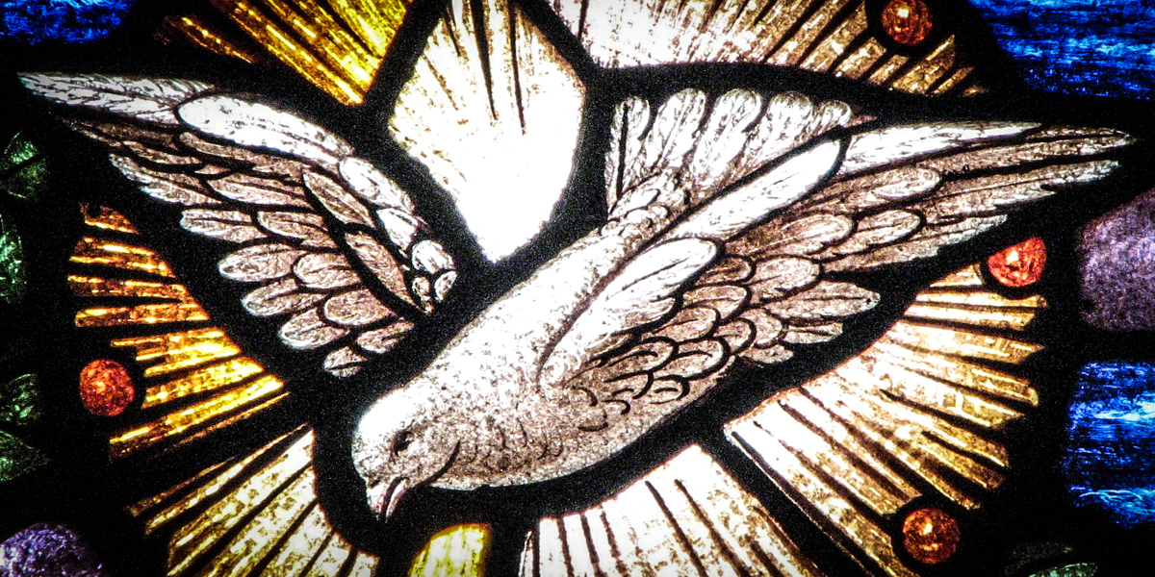
These things God has revealed to us through the Spirit;

Slide 28
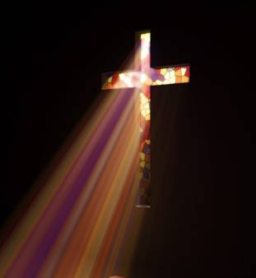
for the Spirit searches everything, even the depths of God.

Slide 29
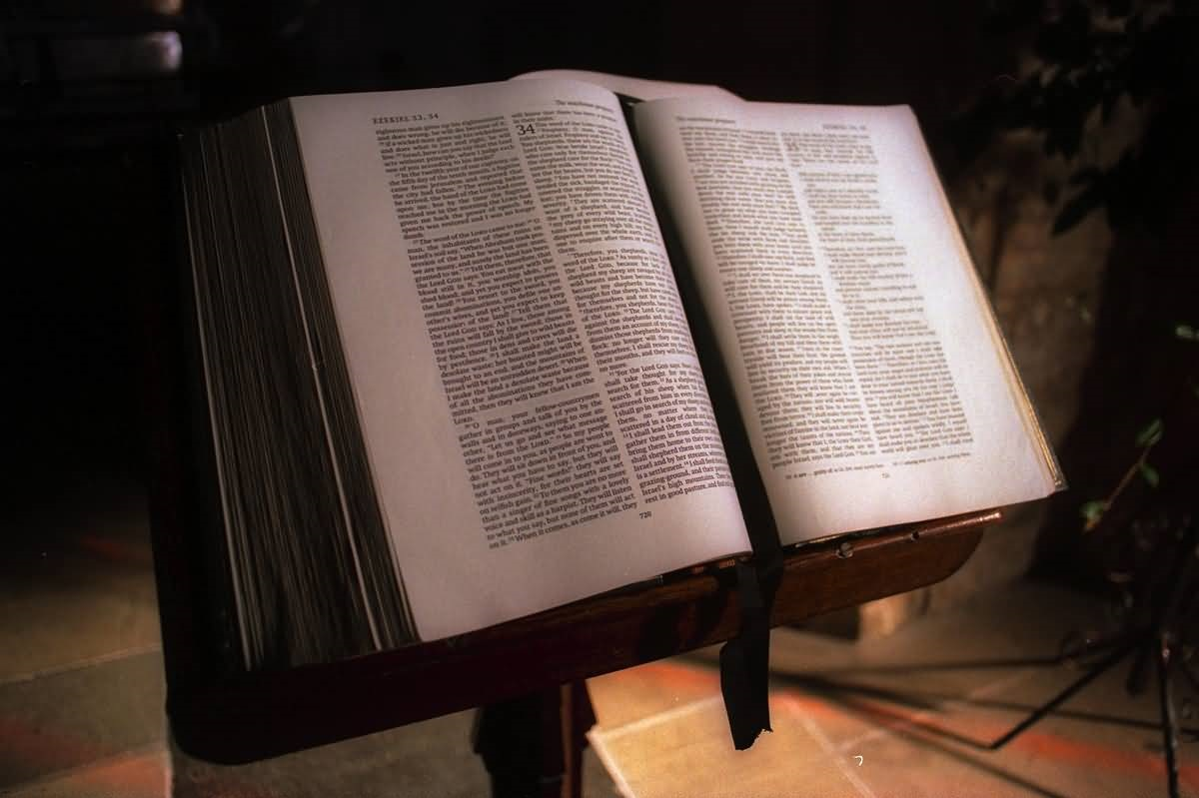
The Word of the Lord
Thanks be to god

Slide 31
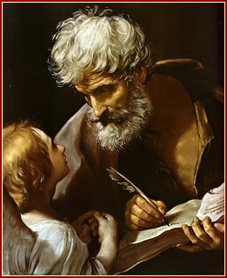
A reading from the
Holy
Gospel according
to Matthew.

Slide 32
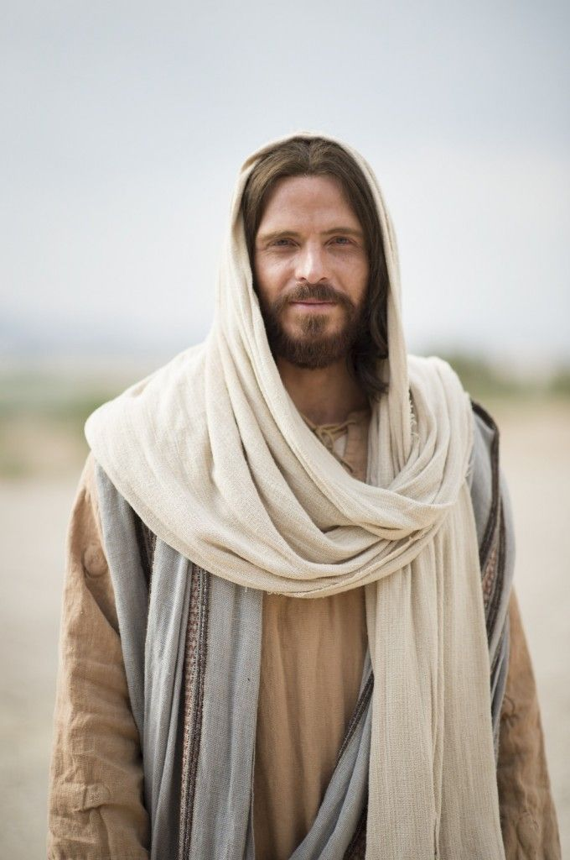
Jesus said to His disciples: “Do not think that I have come to abolish the Law or the Prophets;

Slide 33
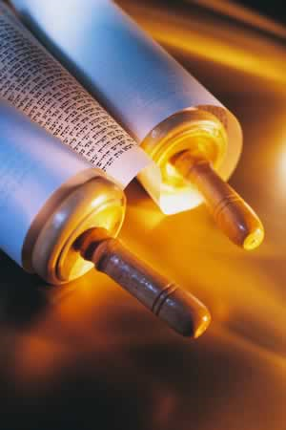
I have come
not to abolish but to fulfill.

Slide 34
“For I tell you, until heaven and earth
pass away,

Slide 35
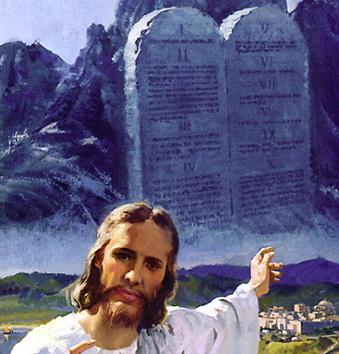
not one letter, not one stroke of a letter, will pass away from the Law until all is accomplished.

Slide 36
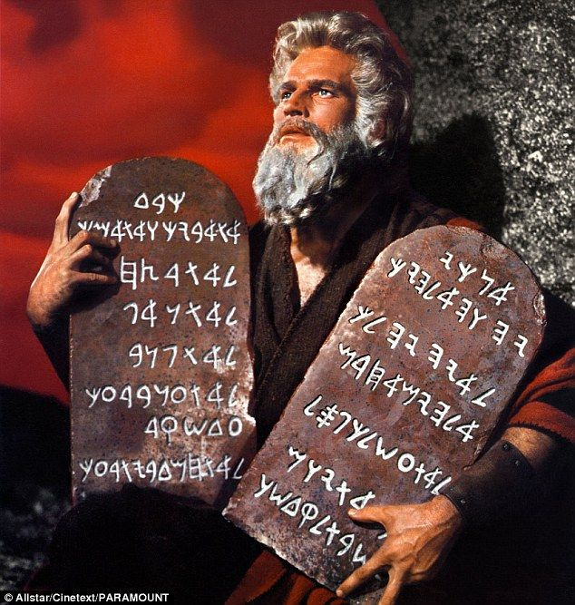
Therefore, whoever breaks one of the least of these commandments, and teaches others to do the same,

Slide 37
will be called least
in the kingdom
of heaven;

Slide 38
but whoever does them and teaches them will be called great in the kingdom of heaven.

Slide 39
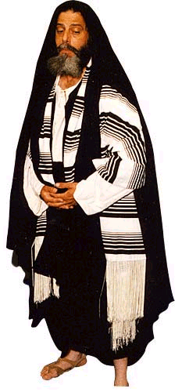
“For I tell you,
unless your righteousness exceeds that
of the scribes
and Pharisees,

Slide 40
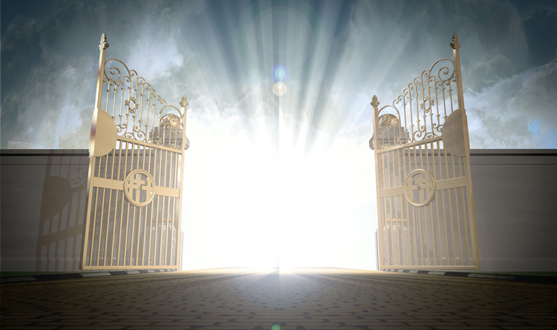
you will never enter the kingdom of heaven.

Slide 41
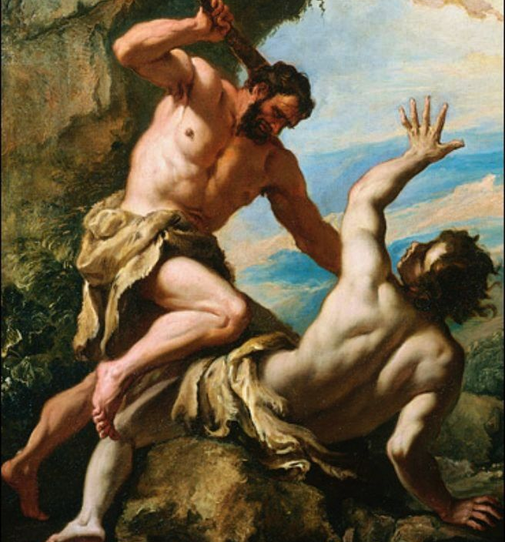
“You have heard that it was said to those of ancient times, ‘You shall not murder’;

Slide 42
and ‘whoever murders shall be liable to judgement.’

Slide 43
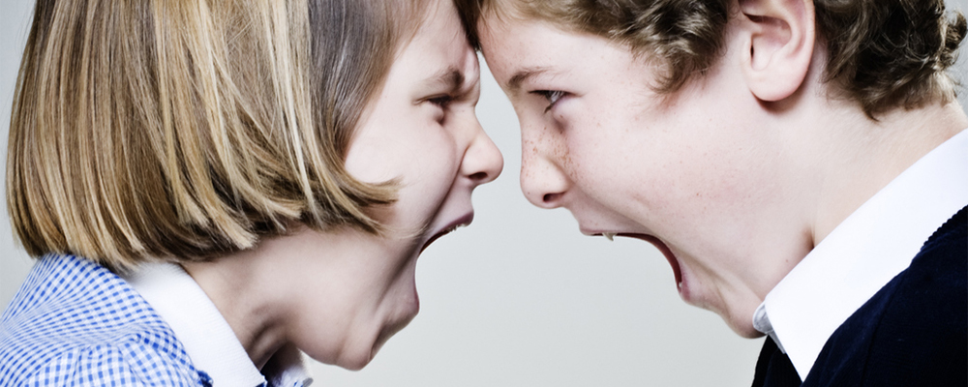
But I say to you that the one who is angry with their brother or sister,

Slide 44
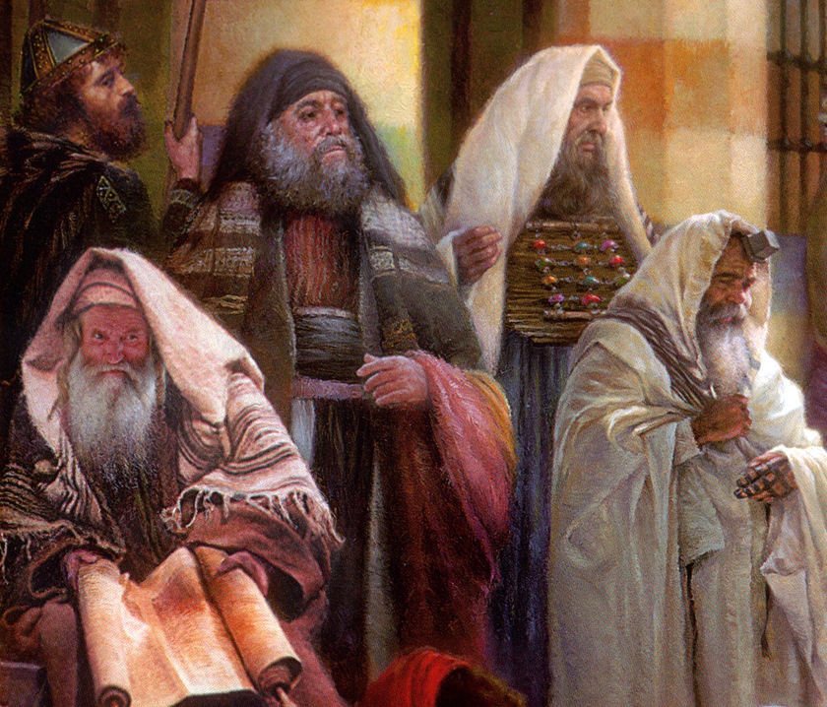
will be liable to judgement; and whoever insults their brother or sister, will be liable to the council;

Slide 45
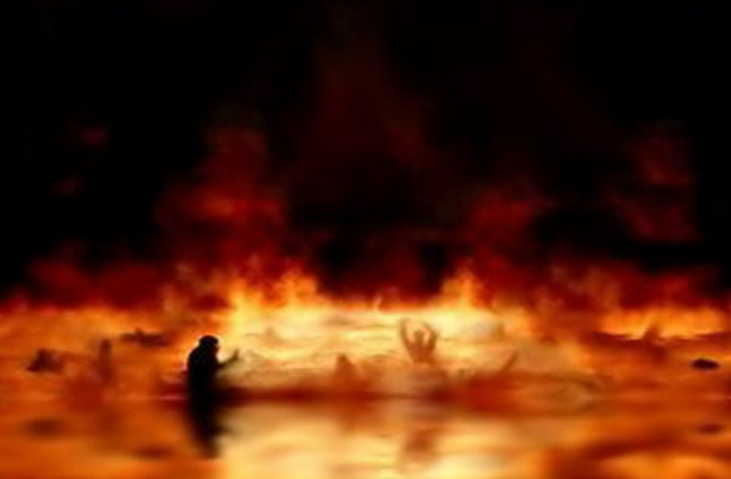
and whoever says, ‘You fool,’ will be liable to the hell of fire.

Slide 46
“So when you are offering your gift at the altar, if you remember that your brother or sister has something against you,

Slide 47
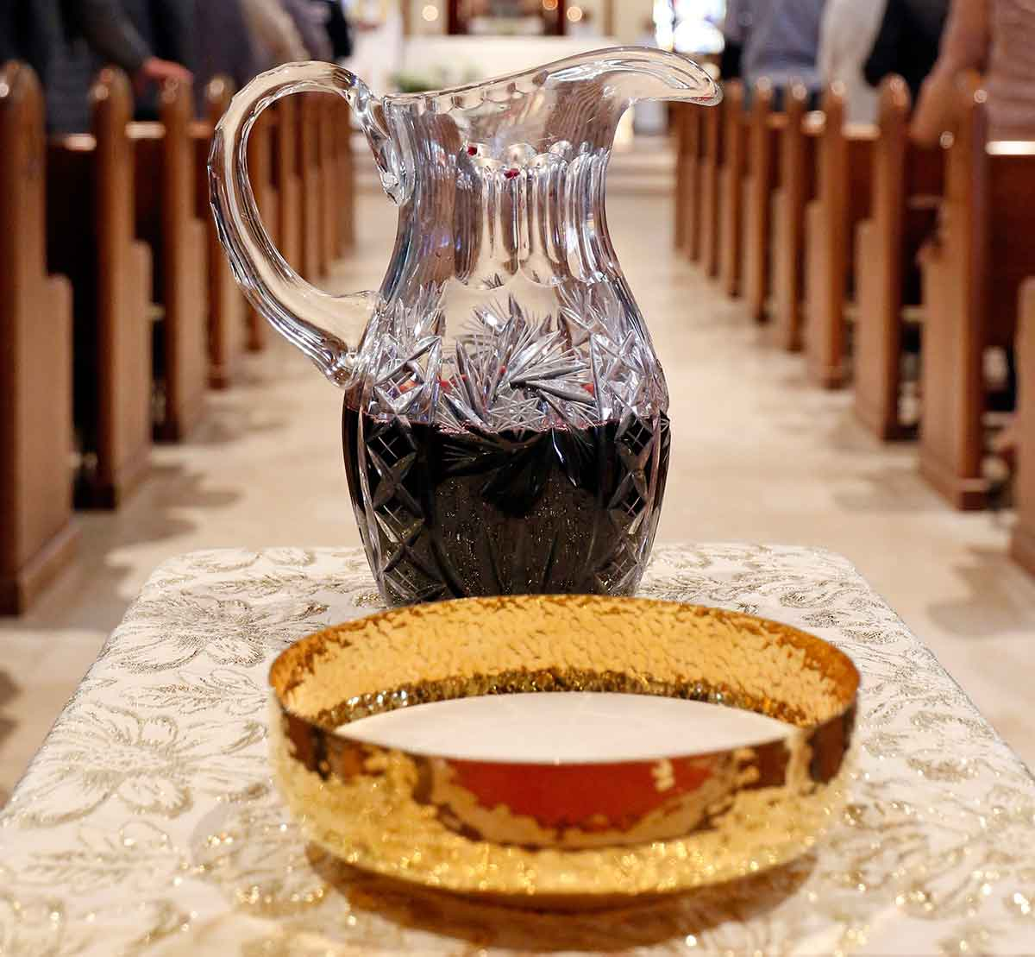
leave your gift there before the altar and go;

Slide 48
first be reconciled
to your brother or sister,

Slide 49
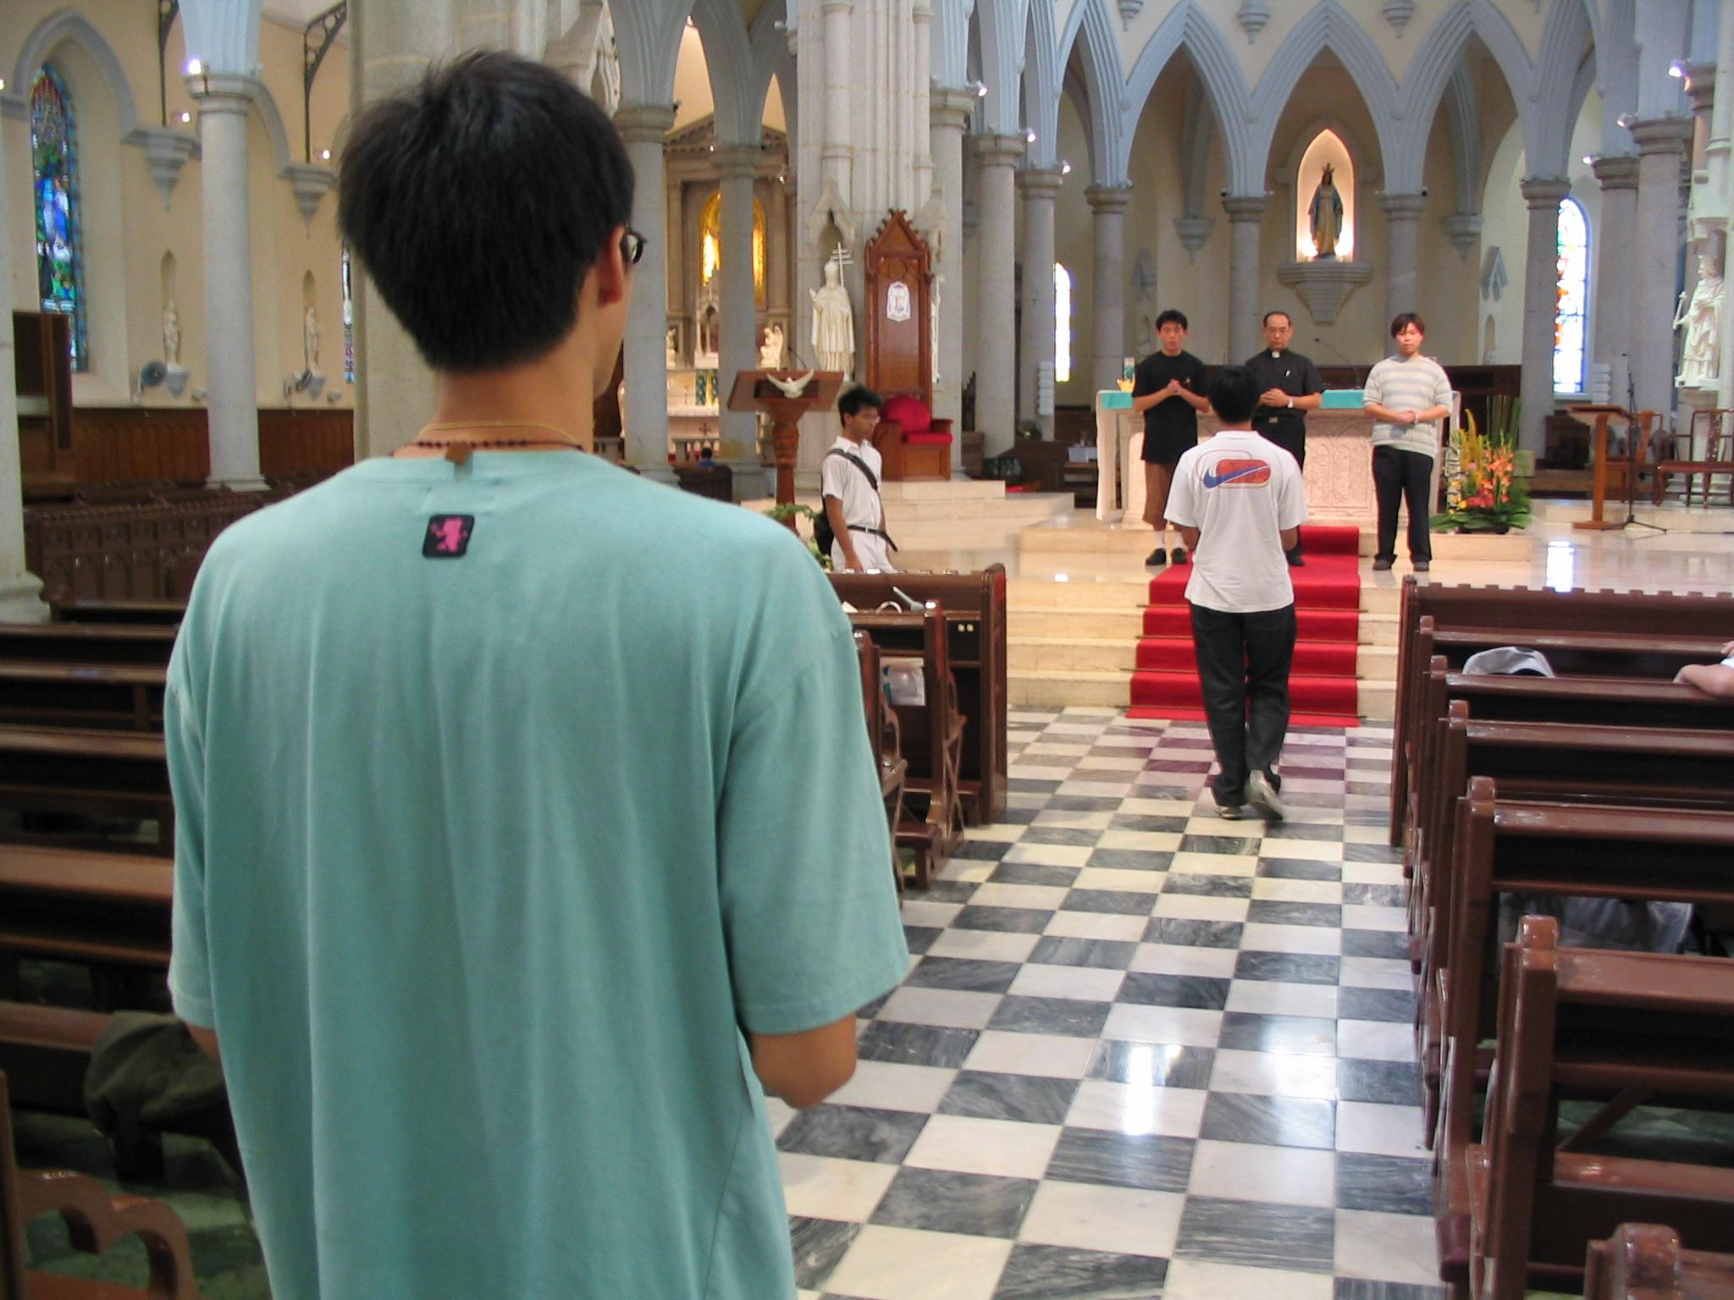
and then come and offer your gift.

Slide 50
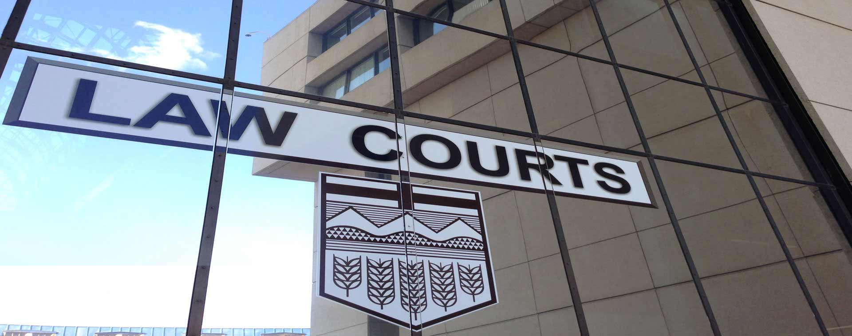
“Come to terms quickly with your accuser
while the two of you are on the way to court,

Slide 51
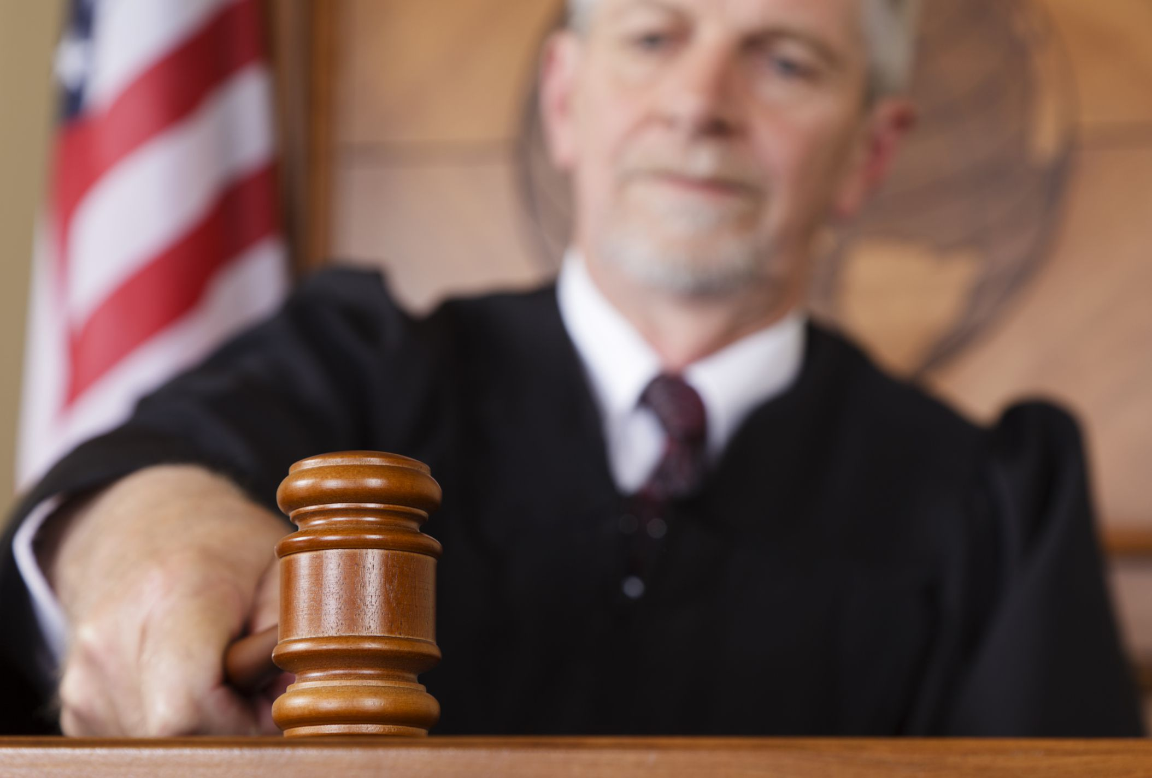
or your accuser may hand you over to the judge,

Slide 52
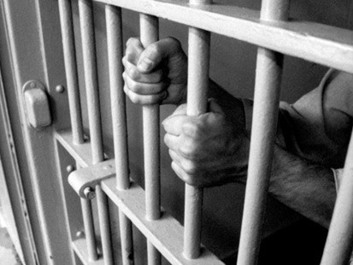
and the judge to the guard,
and you will be thrown
into prison.

Slide 53
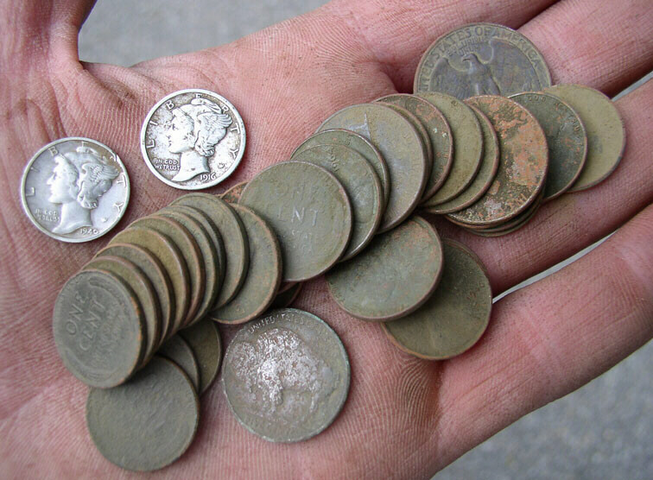
Truly I tell you, you will never get out until you have paid the last penny.

Slide 54
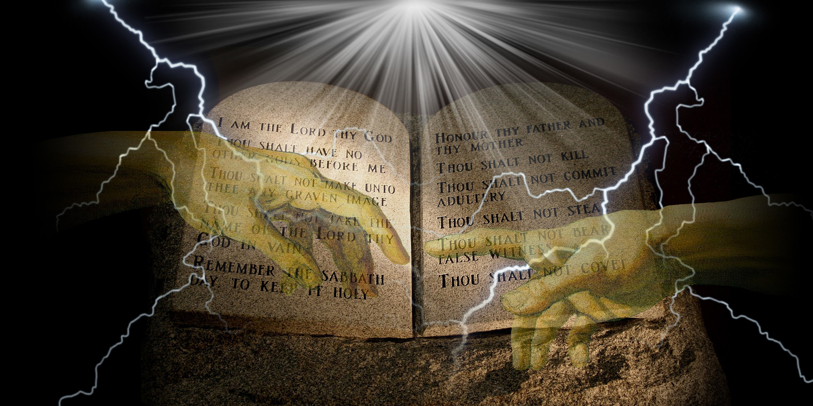
“You have heard
that it was said,
‘You shall not commit adultery.’

Slide 55
“But I say to you that everyone who looks at a woman with lust has already committed adultery with her in his heart

Slide 56
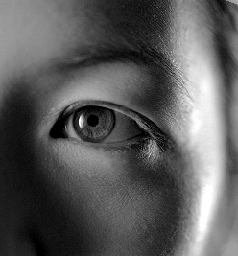
“If your right eye causes you to sin, tear it out and throw it away;

Slide 57
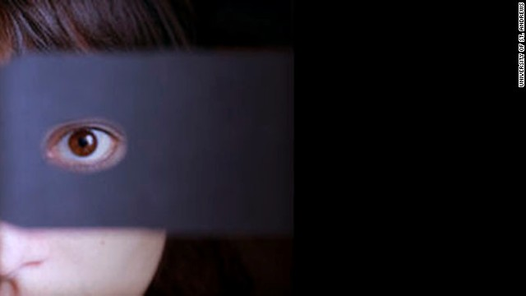
it is better for you to lose one of your members

Slide 58
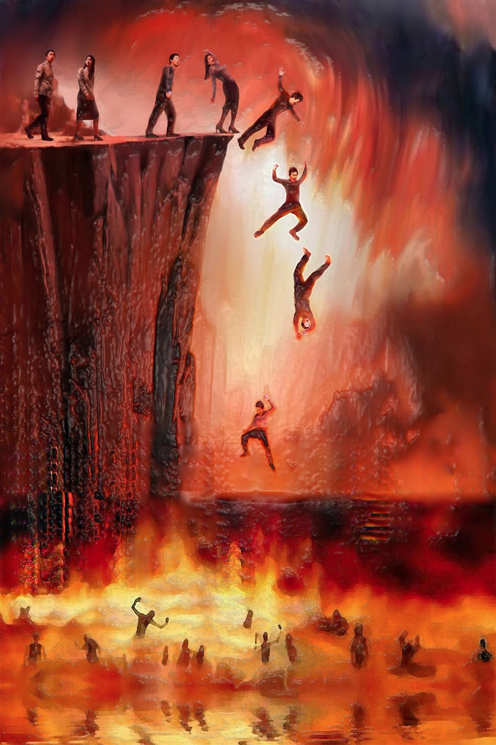
than for your whole body to be thrown into hell.

Slide 59
And if your right hand causes you to sin, cut it off and throw it away;

Slide 60
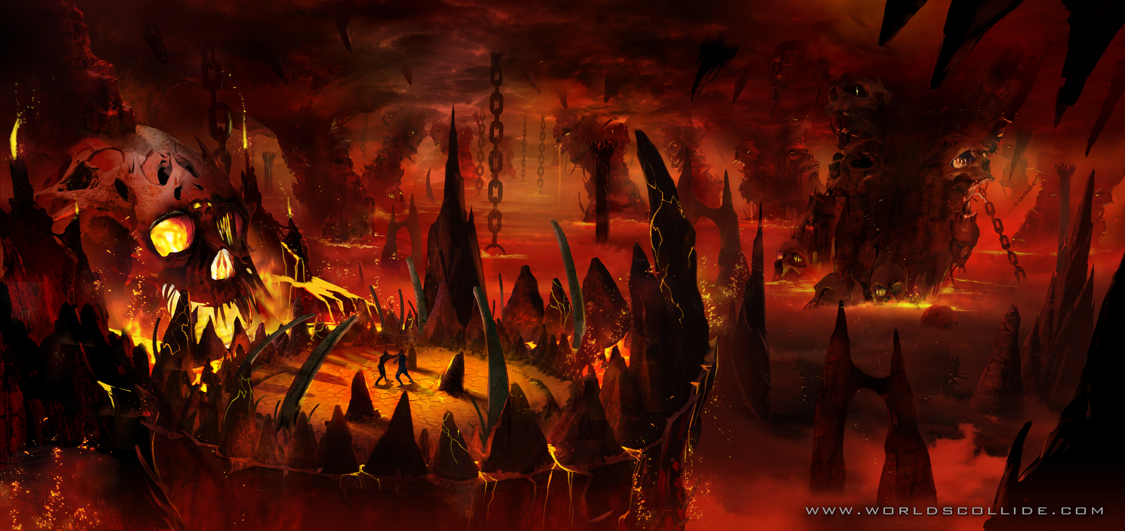
it is better for you to lose one of your members than for your whole body to go into hell.

Slide 61
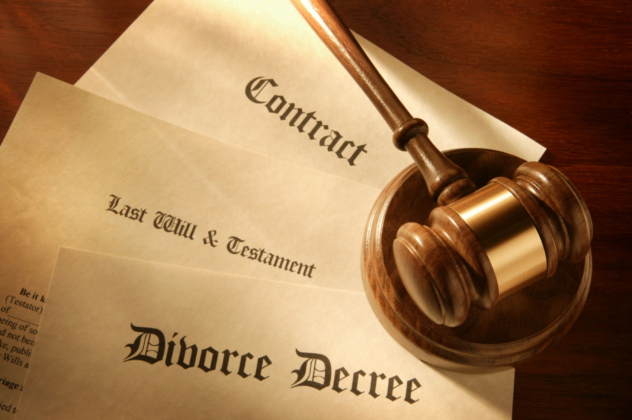
It was also said, “Whoever divorces his wife, let him give her a certificate of divorce.”

Slide 62
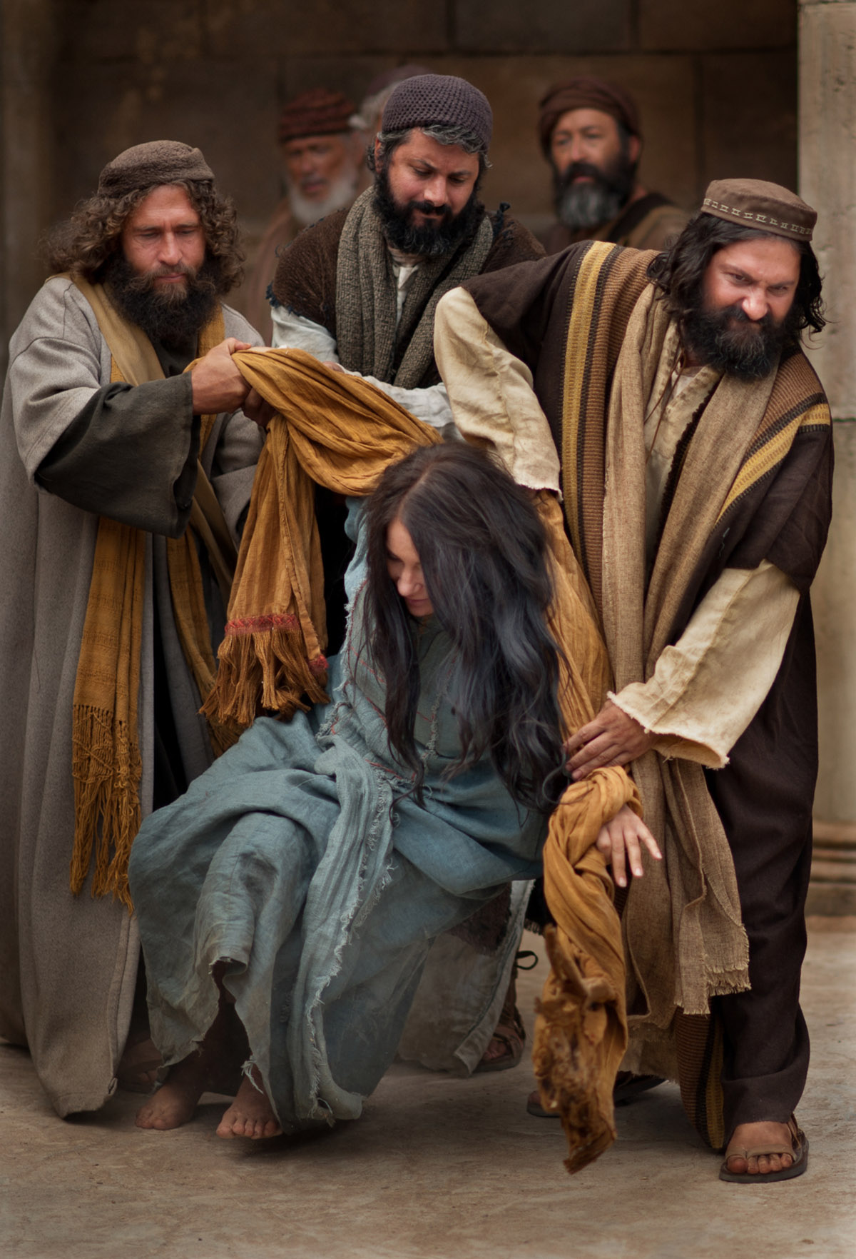
But I say to you that anyone who divorces his wife, except on the ground of unchastity, causes her to commit adultery;

Slide 63
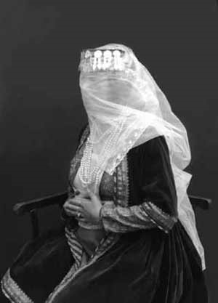
and whoever marries a divorced woman commits adultery.

Slide 64
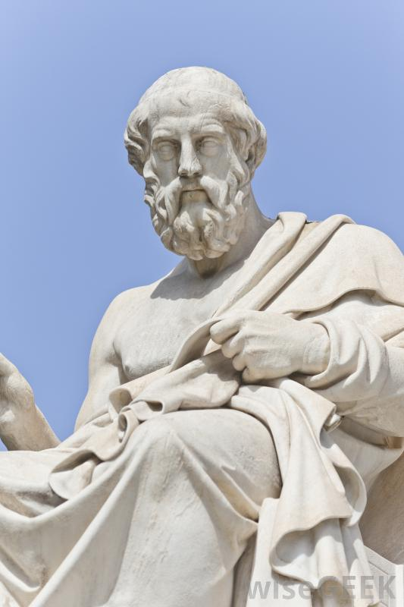
“Again, you have heard that it was said to those of ancient times,

Slide 65
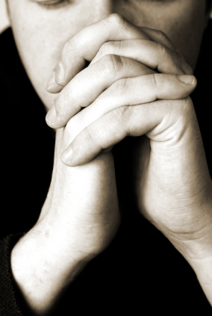
‘You shall not swear falsely but carry out the vows you have made to the Lord.’

Slide 66
But I say to you:
Do not swear at all
either by heaven,

Slide 67
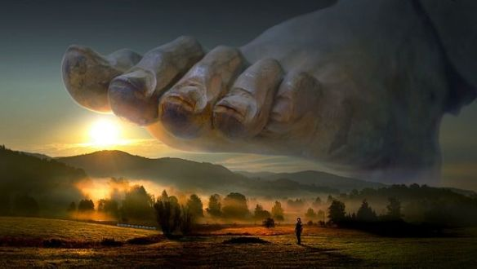
for it is the throne of God,
or by the earth,
for it is His footstool,

Slide 68
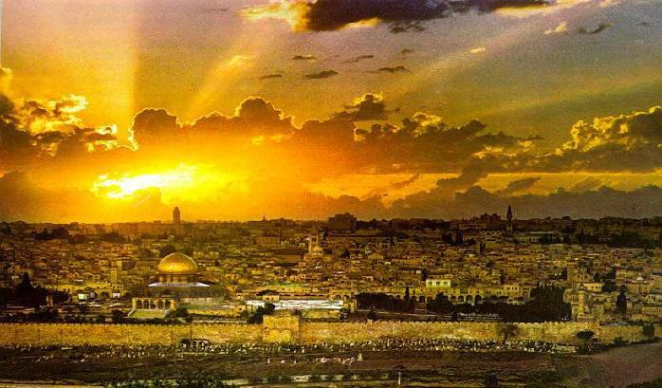
or by Jerusalem, for it is the city of the great King.

Slide 69
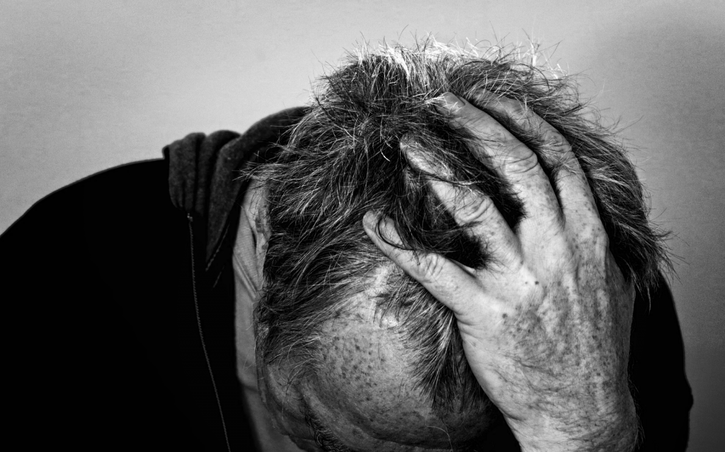
And do not swear by your head, for you cannot make one hair white or black.

Slide 70
“Let your word be ‘Yes,’ if ‘Yes,’ or ‘No,’ if ‘No’; anything more than this comes from the evil one.”

Slide 71
The gospel of the Lord
Il-Kelma tal-Mulej
Tifħir lilek Kristu

